Slide 1
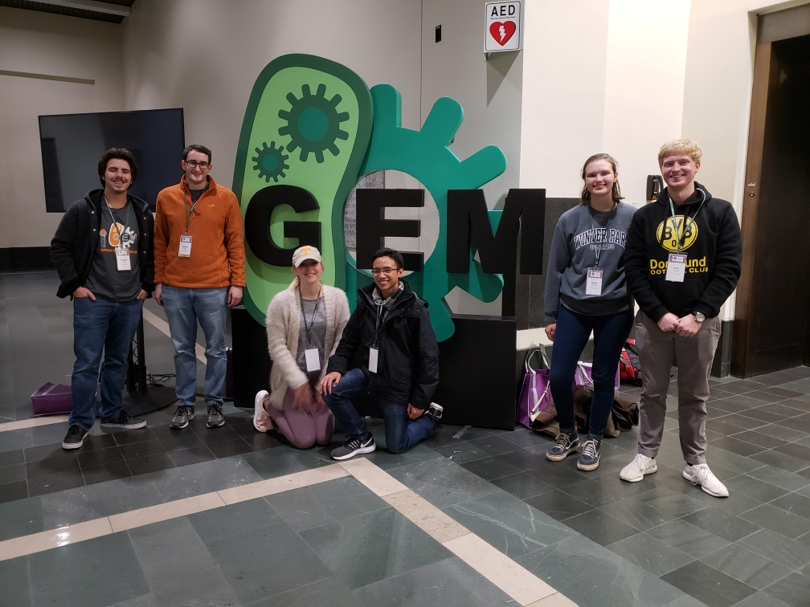
University of Tennessee, Knoxville iGEM
Giant Jamboree Conference 2018

Slide 2
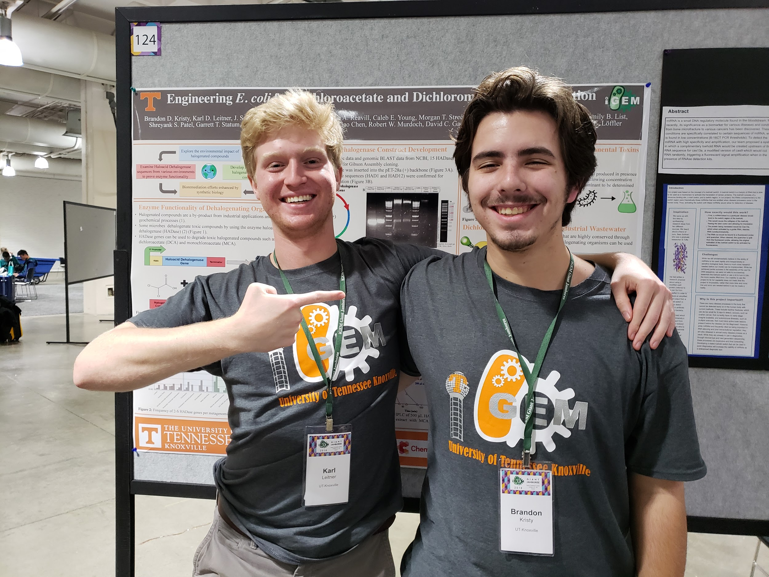
The Haloacid Dehalogenase team, Karl Leitner and Brandon Kristy

Slide 3
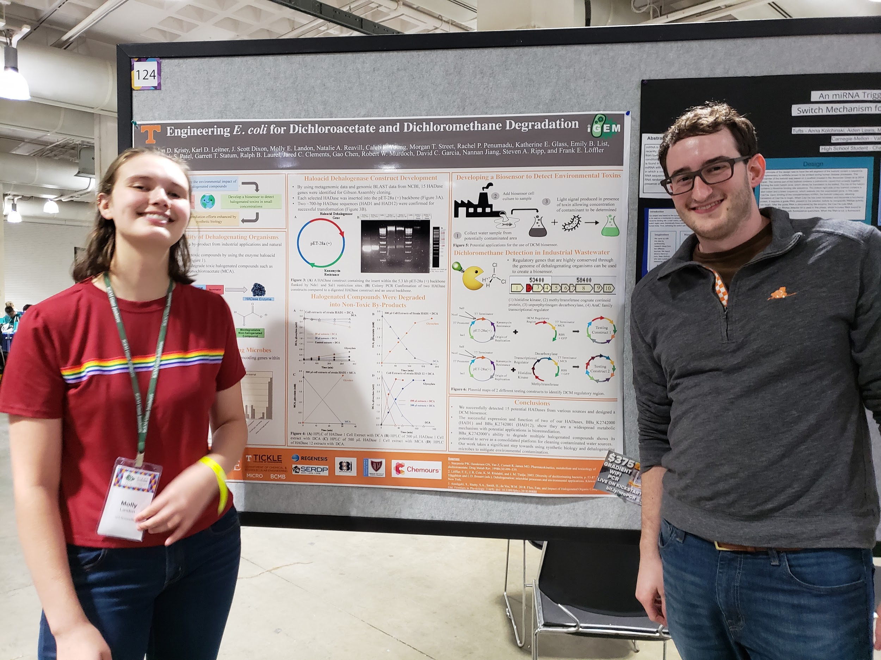
The Dichloromethane Biosensor team, Molly Landon and Scott Dixon

Slide 4
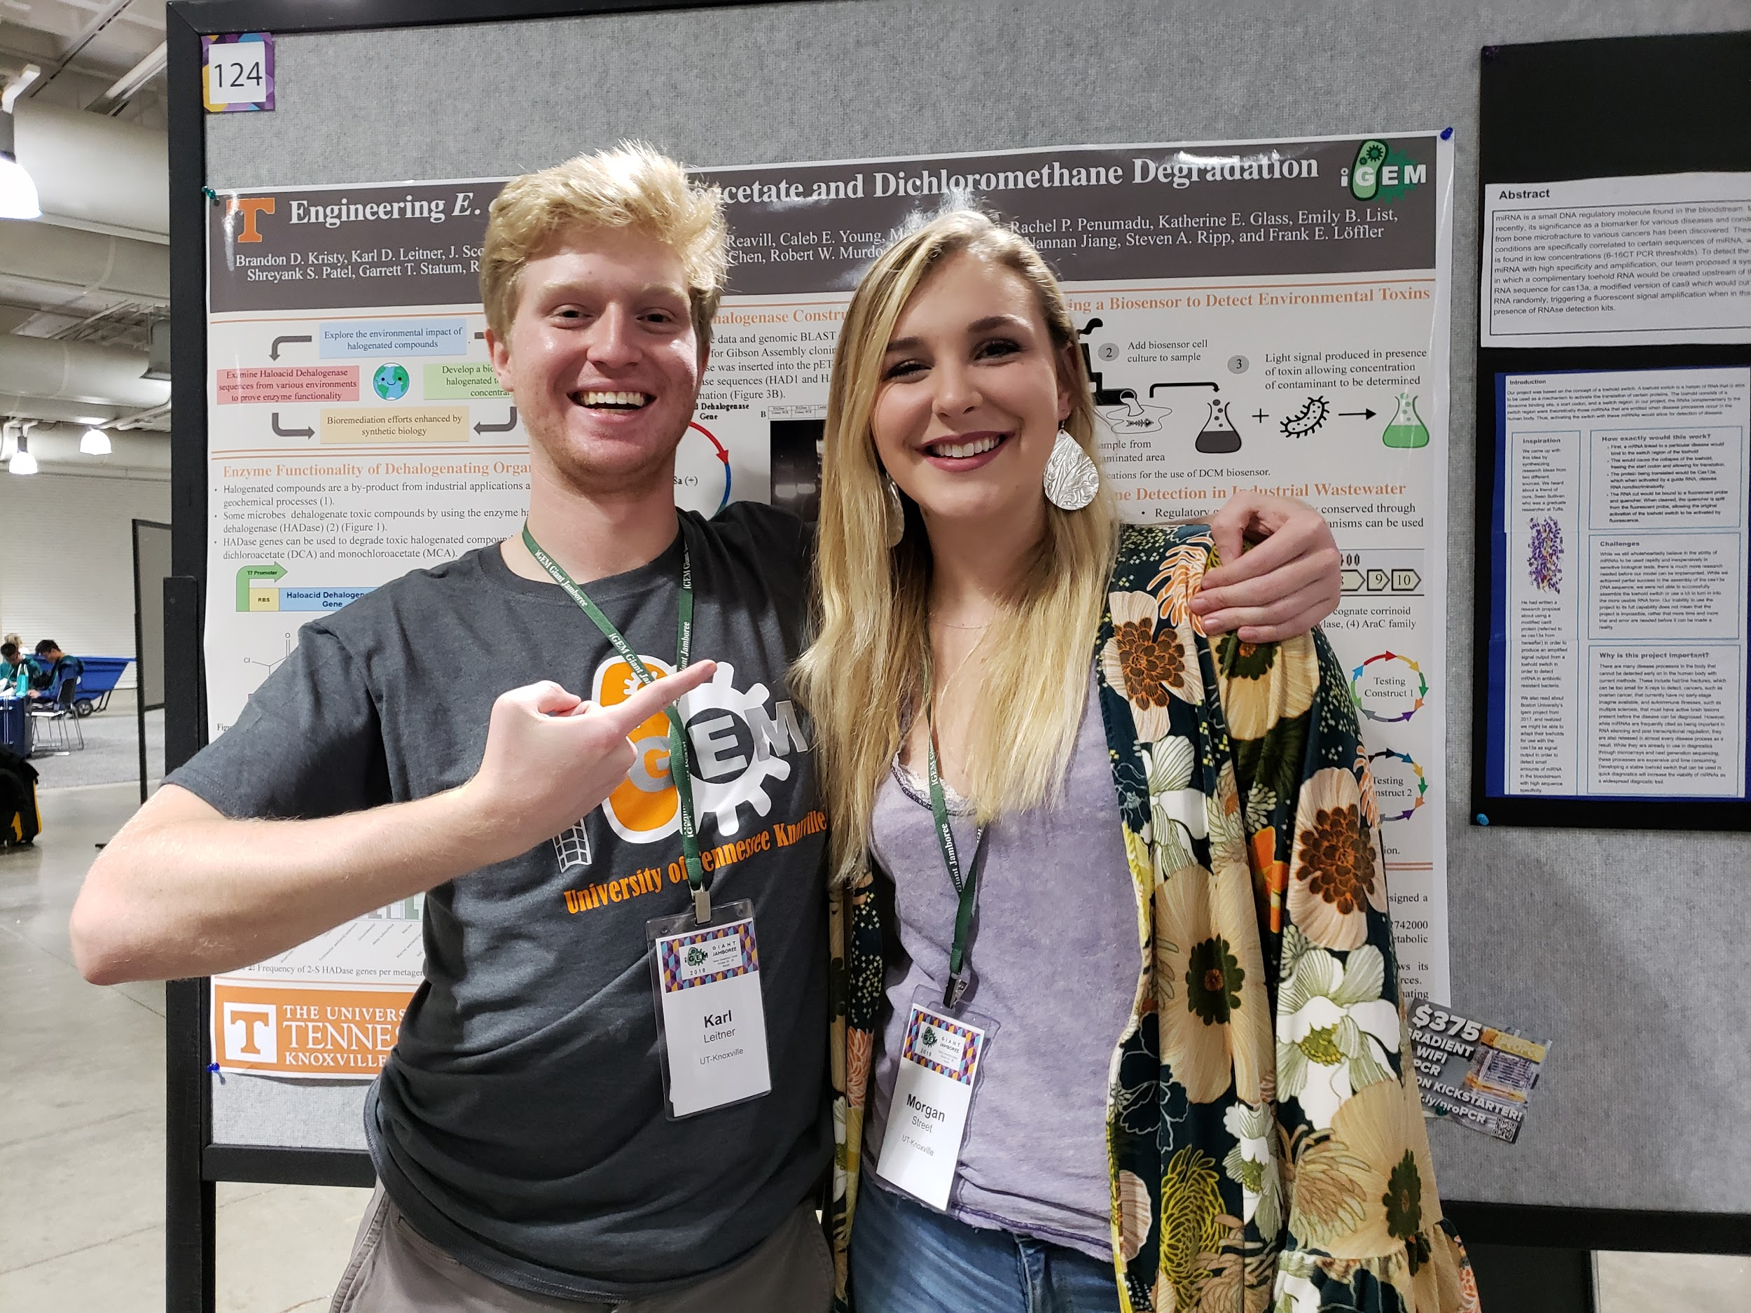
The Interlab team, Karl Leitner and Morgan Street

Slide 5
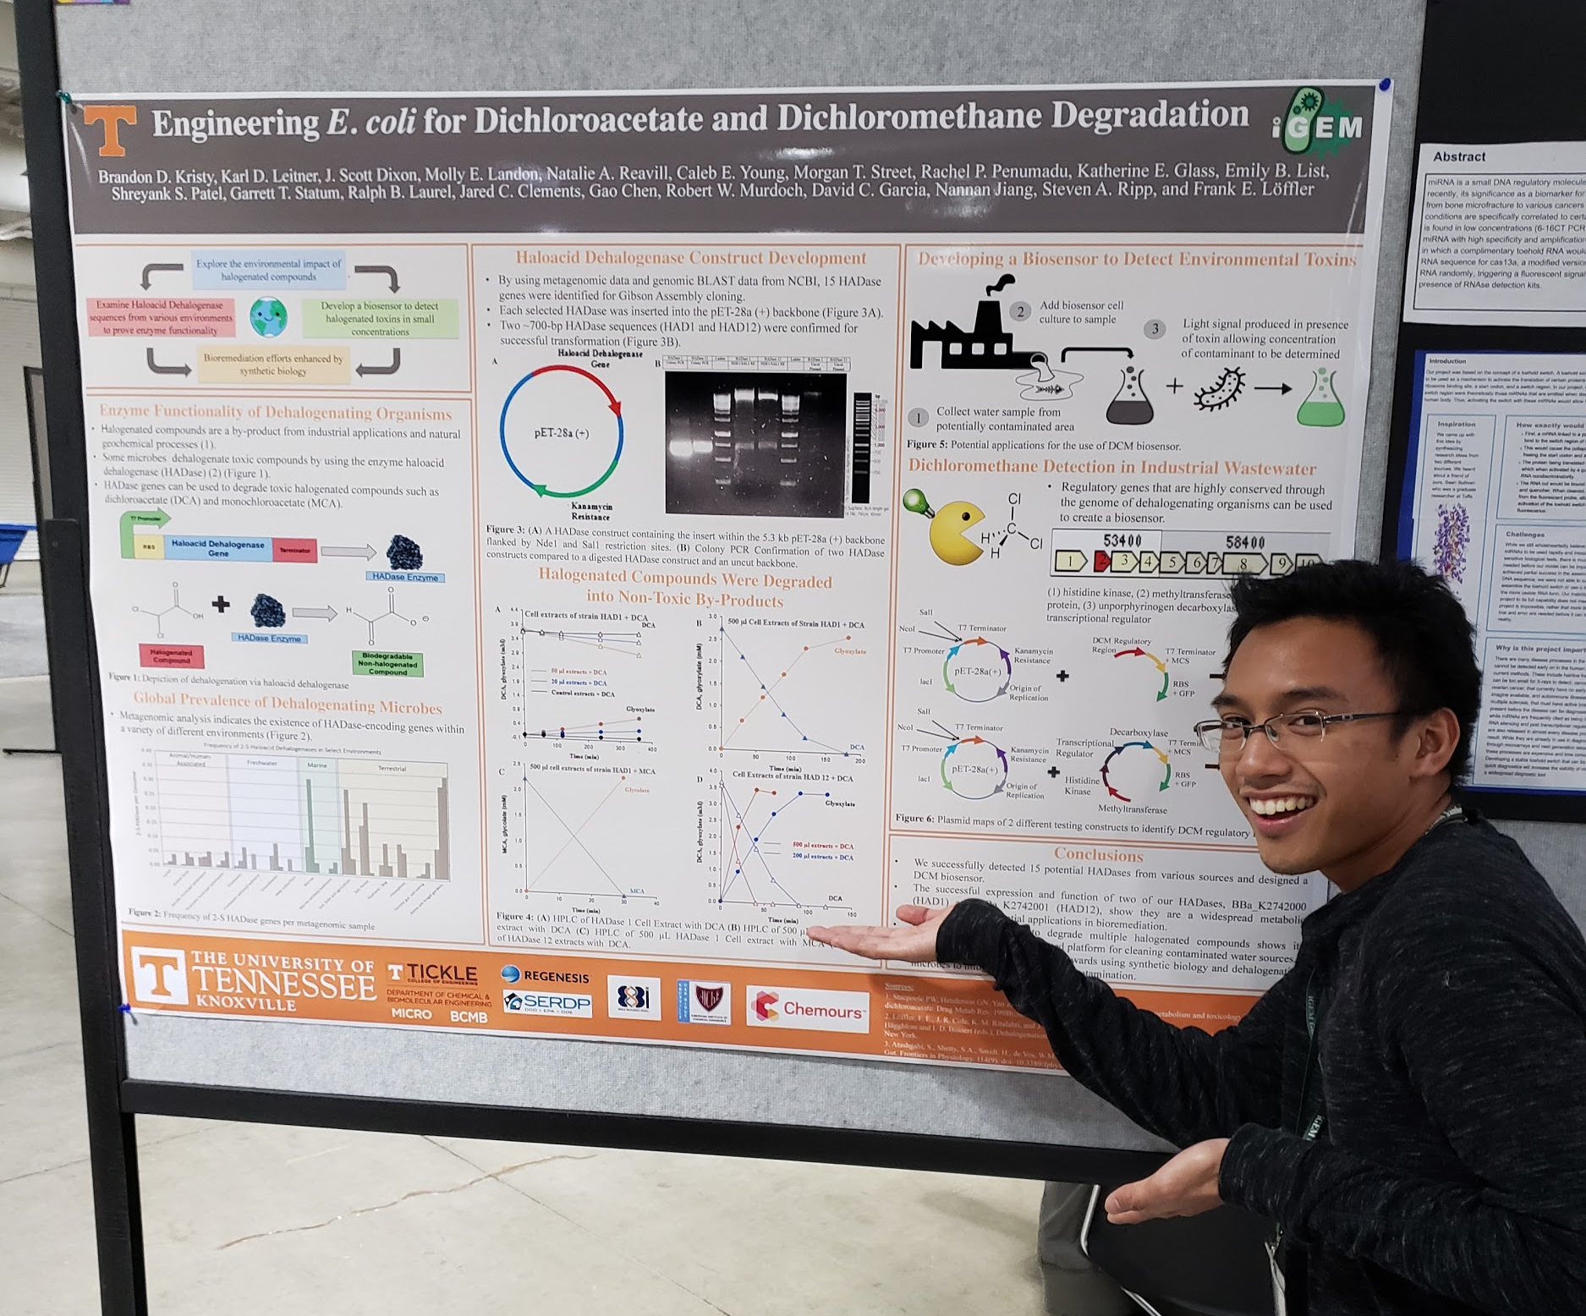
Team leader and logistics coordinator, Ralph Laurel

Slide 6
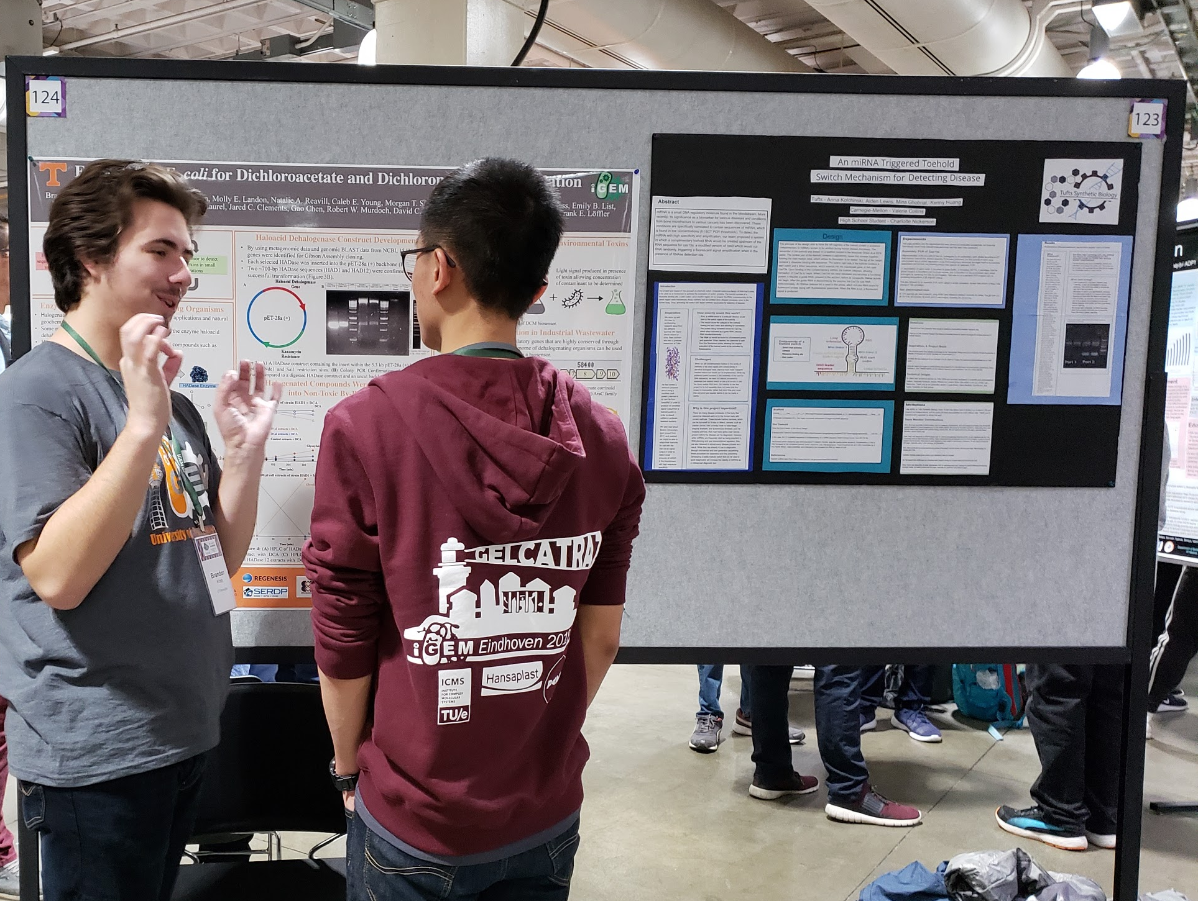
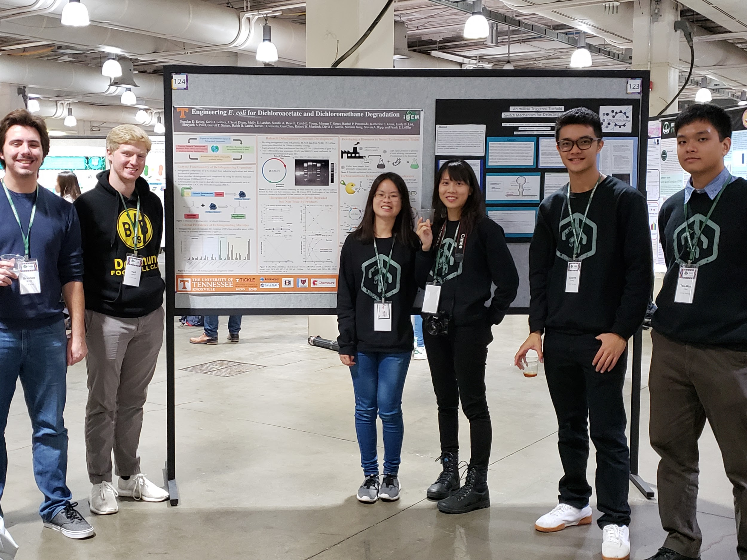
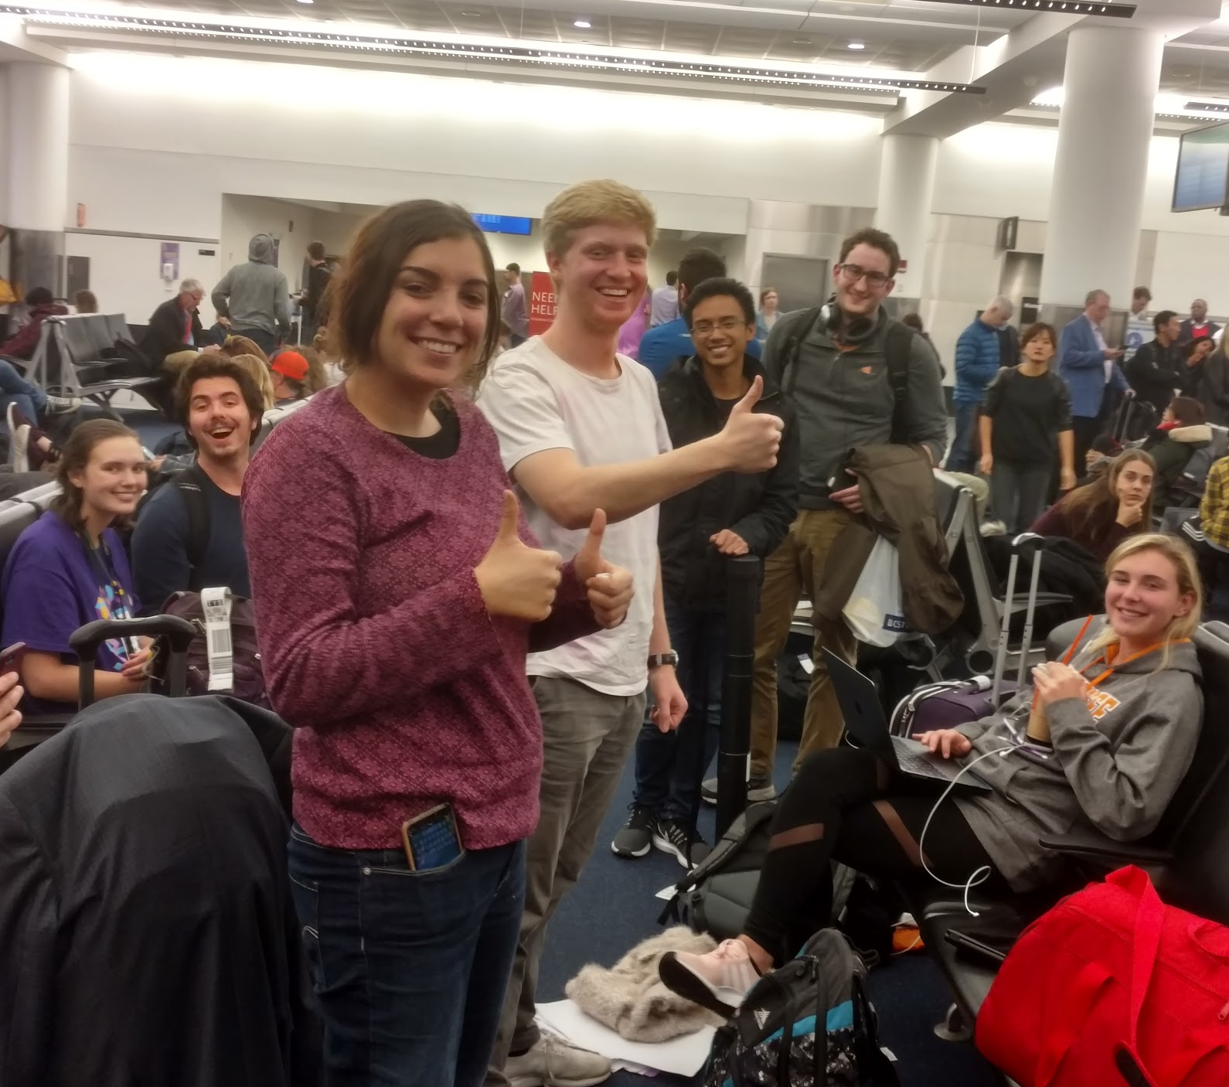
Making Friends from Around the World

Slide 7
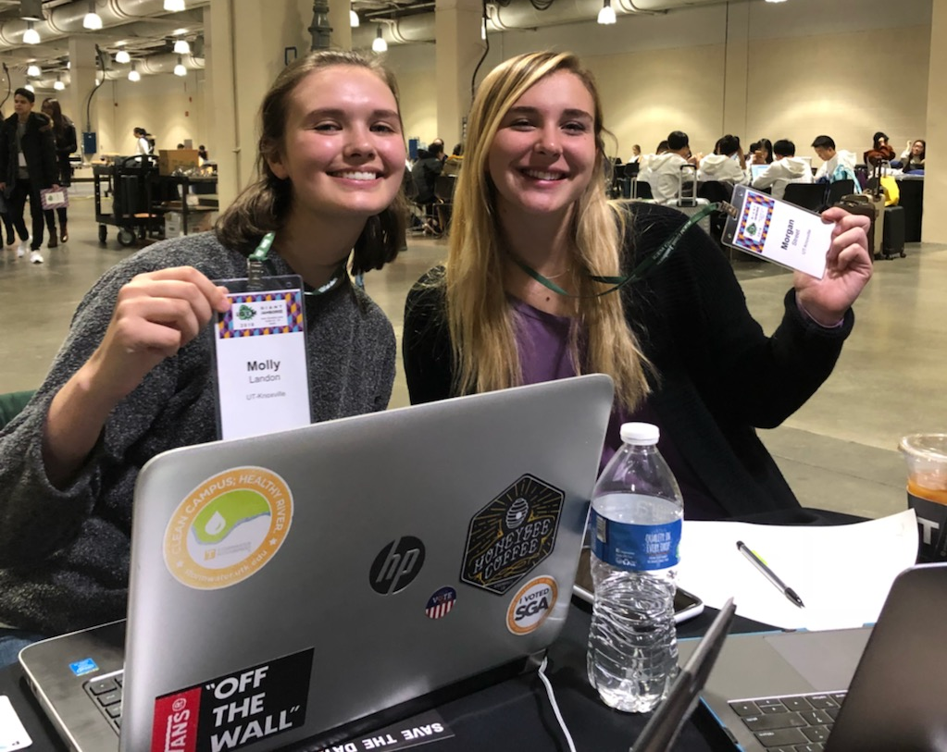
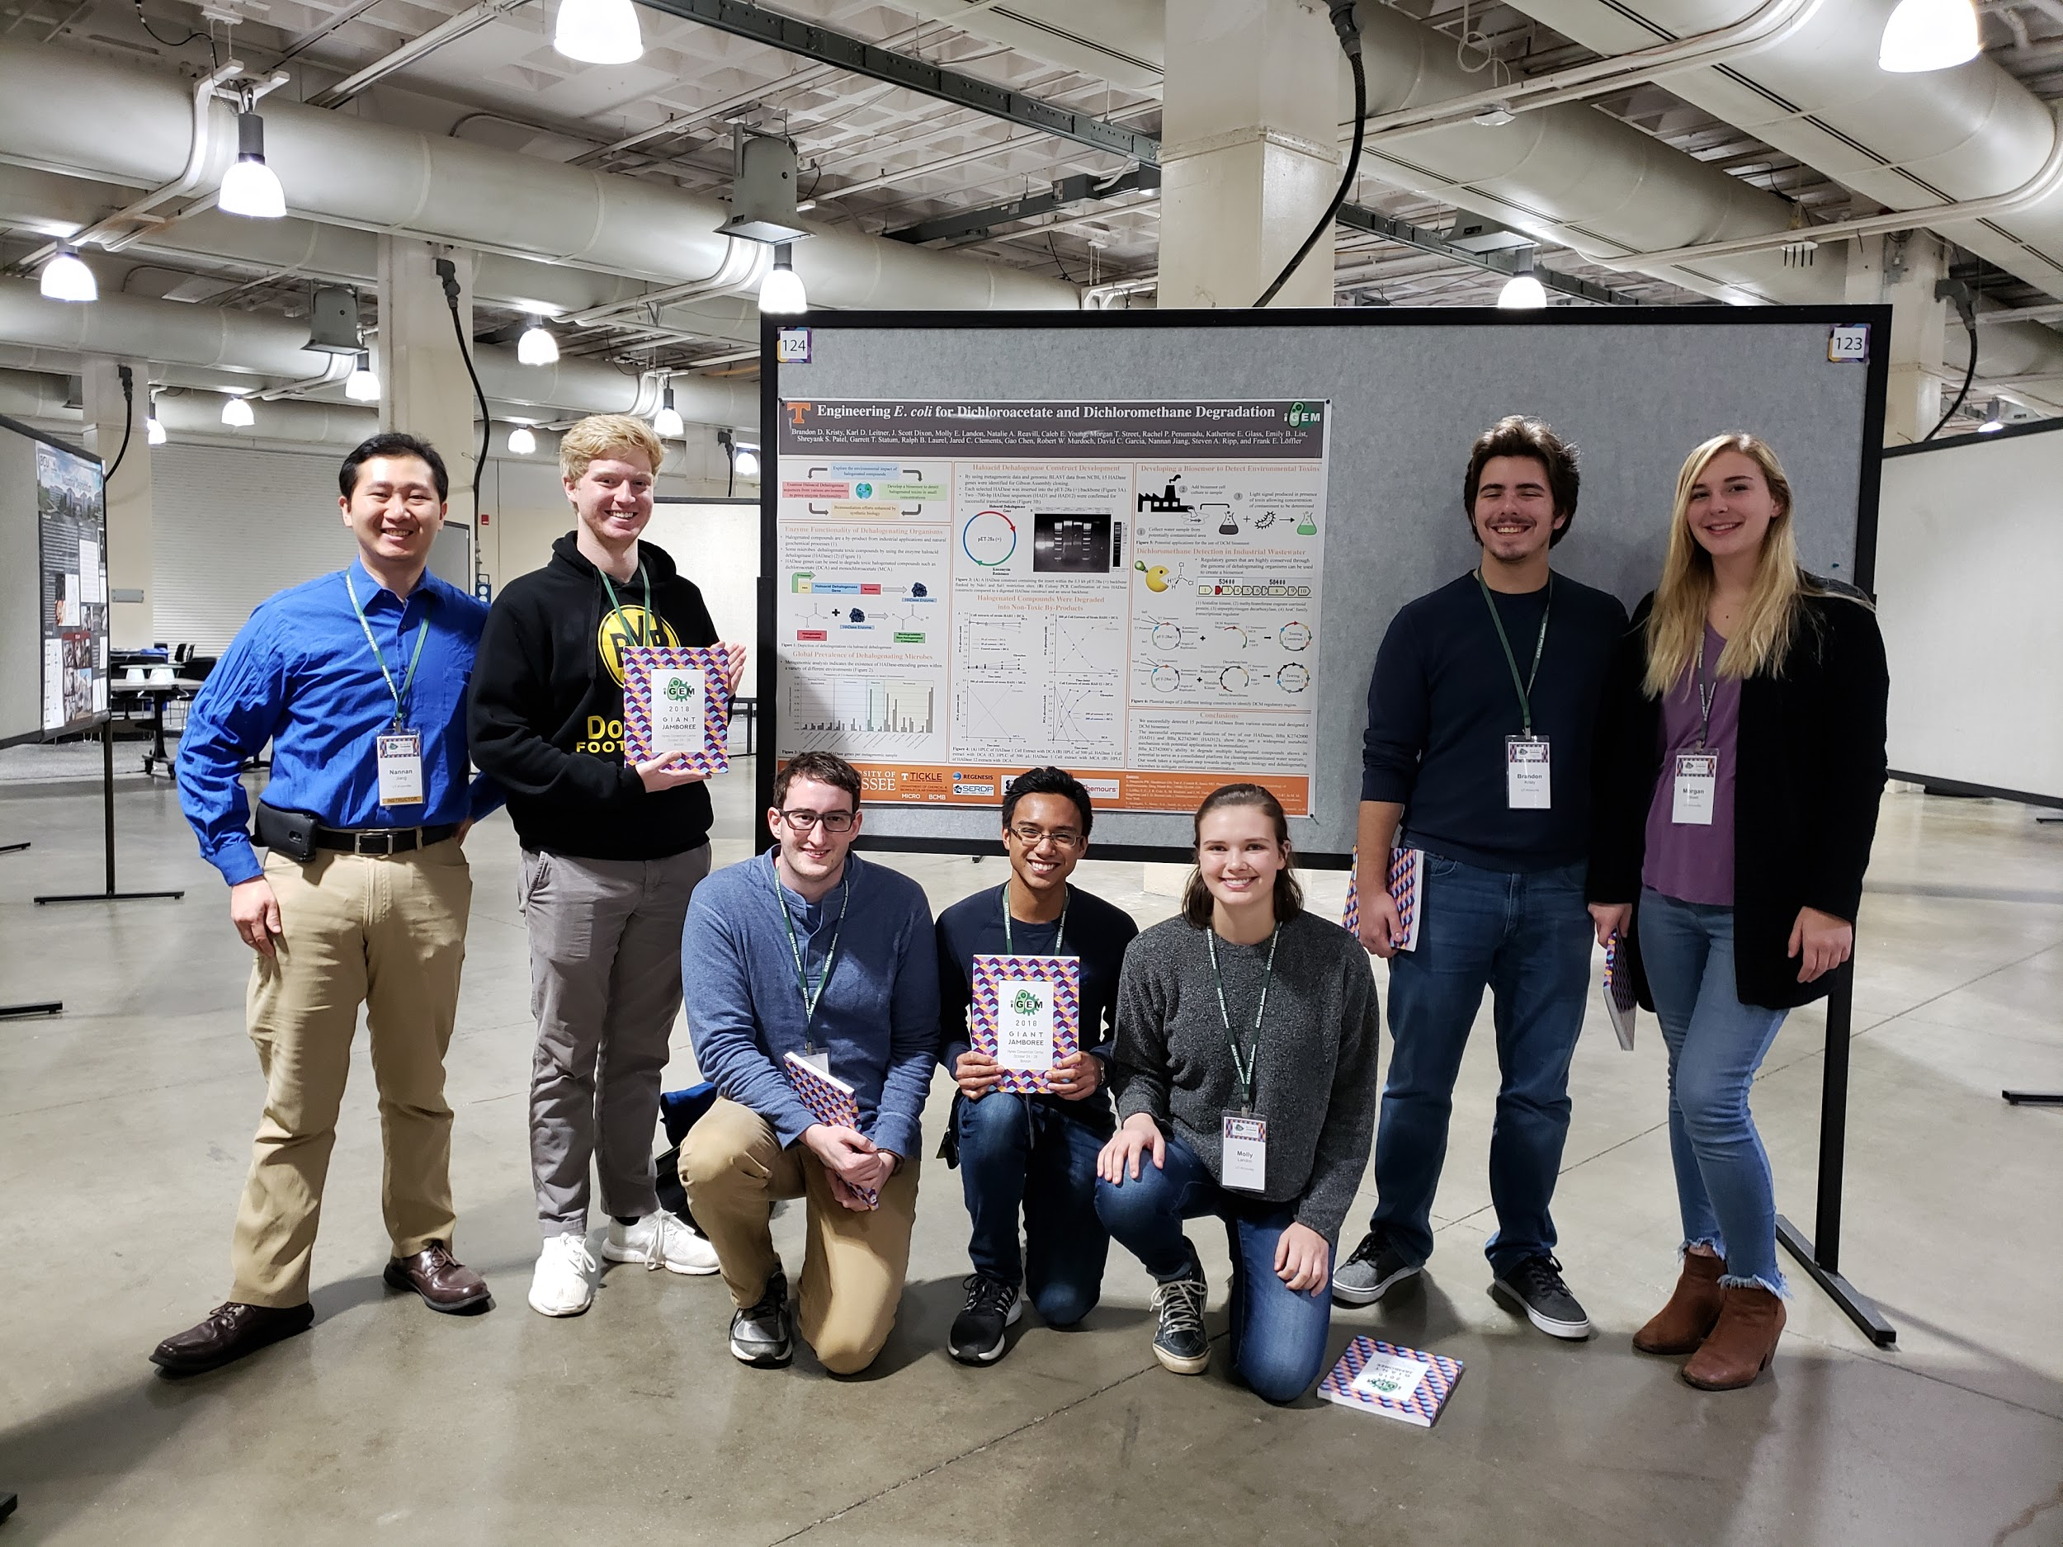
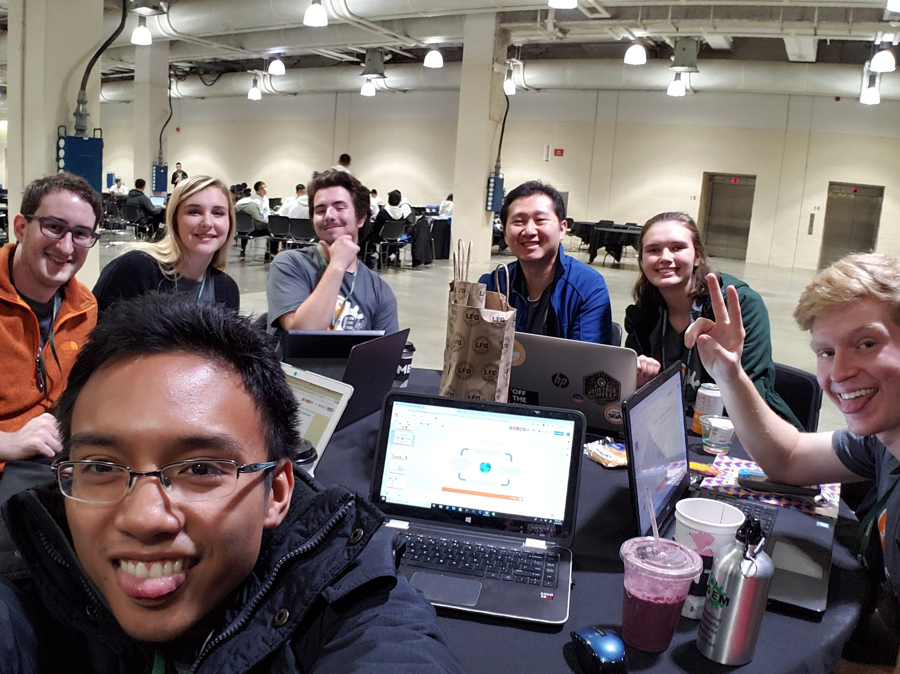
Preparing for Our Presentation
Graduate student advisor Nannan Jiang poses with the team and their poster

Slide 8
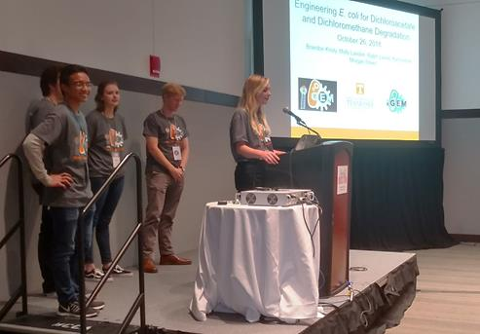
Presentation
Morgan Street begins the on-stage presentation

Slide 9
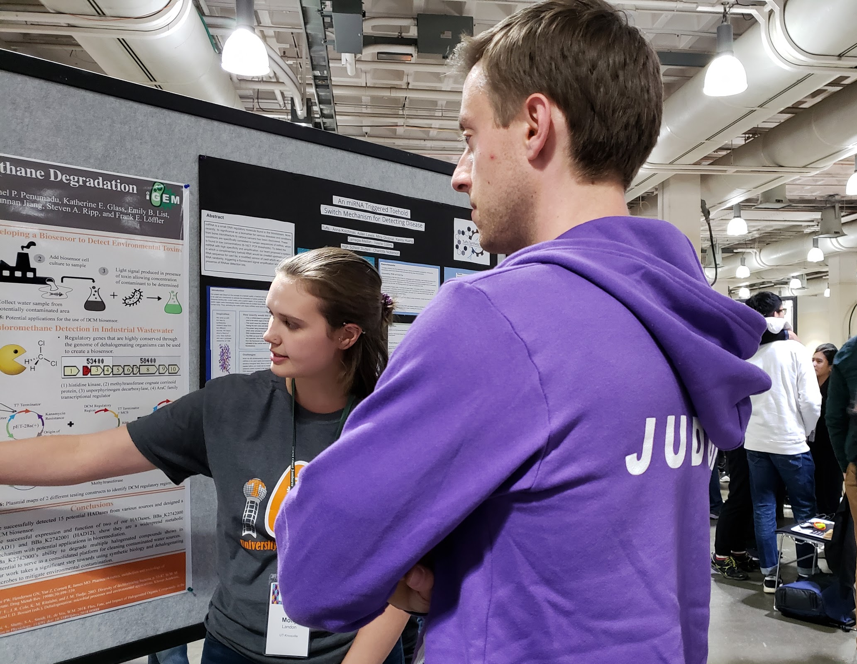
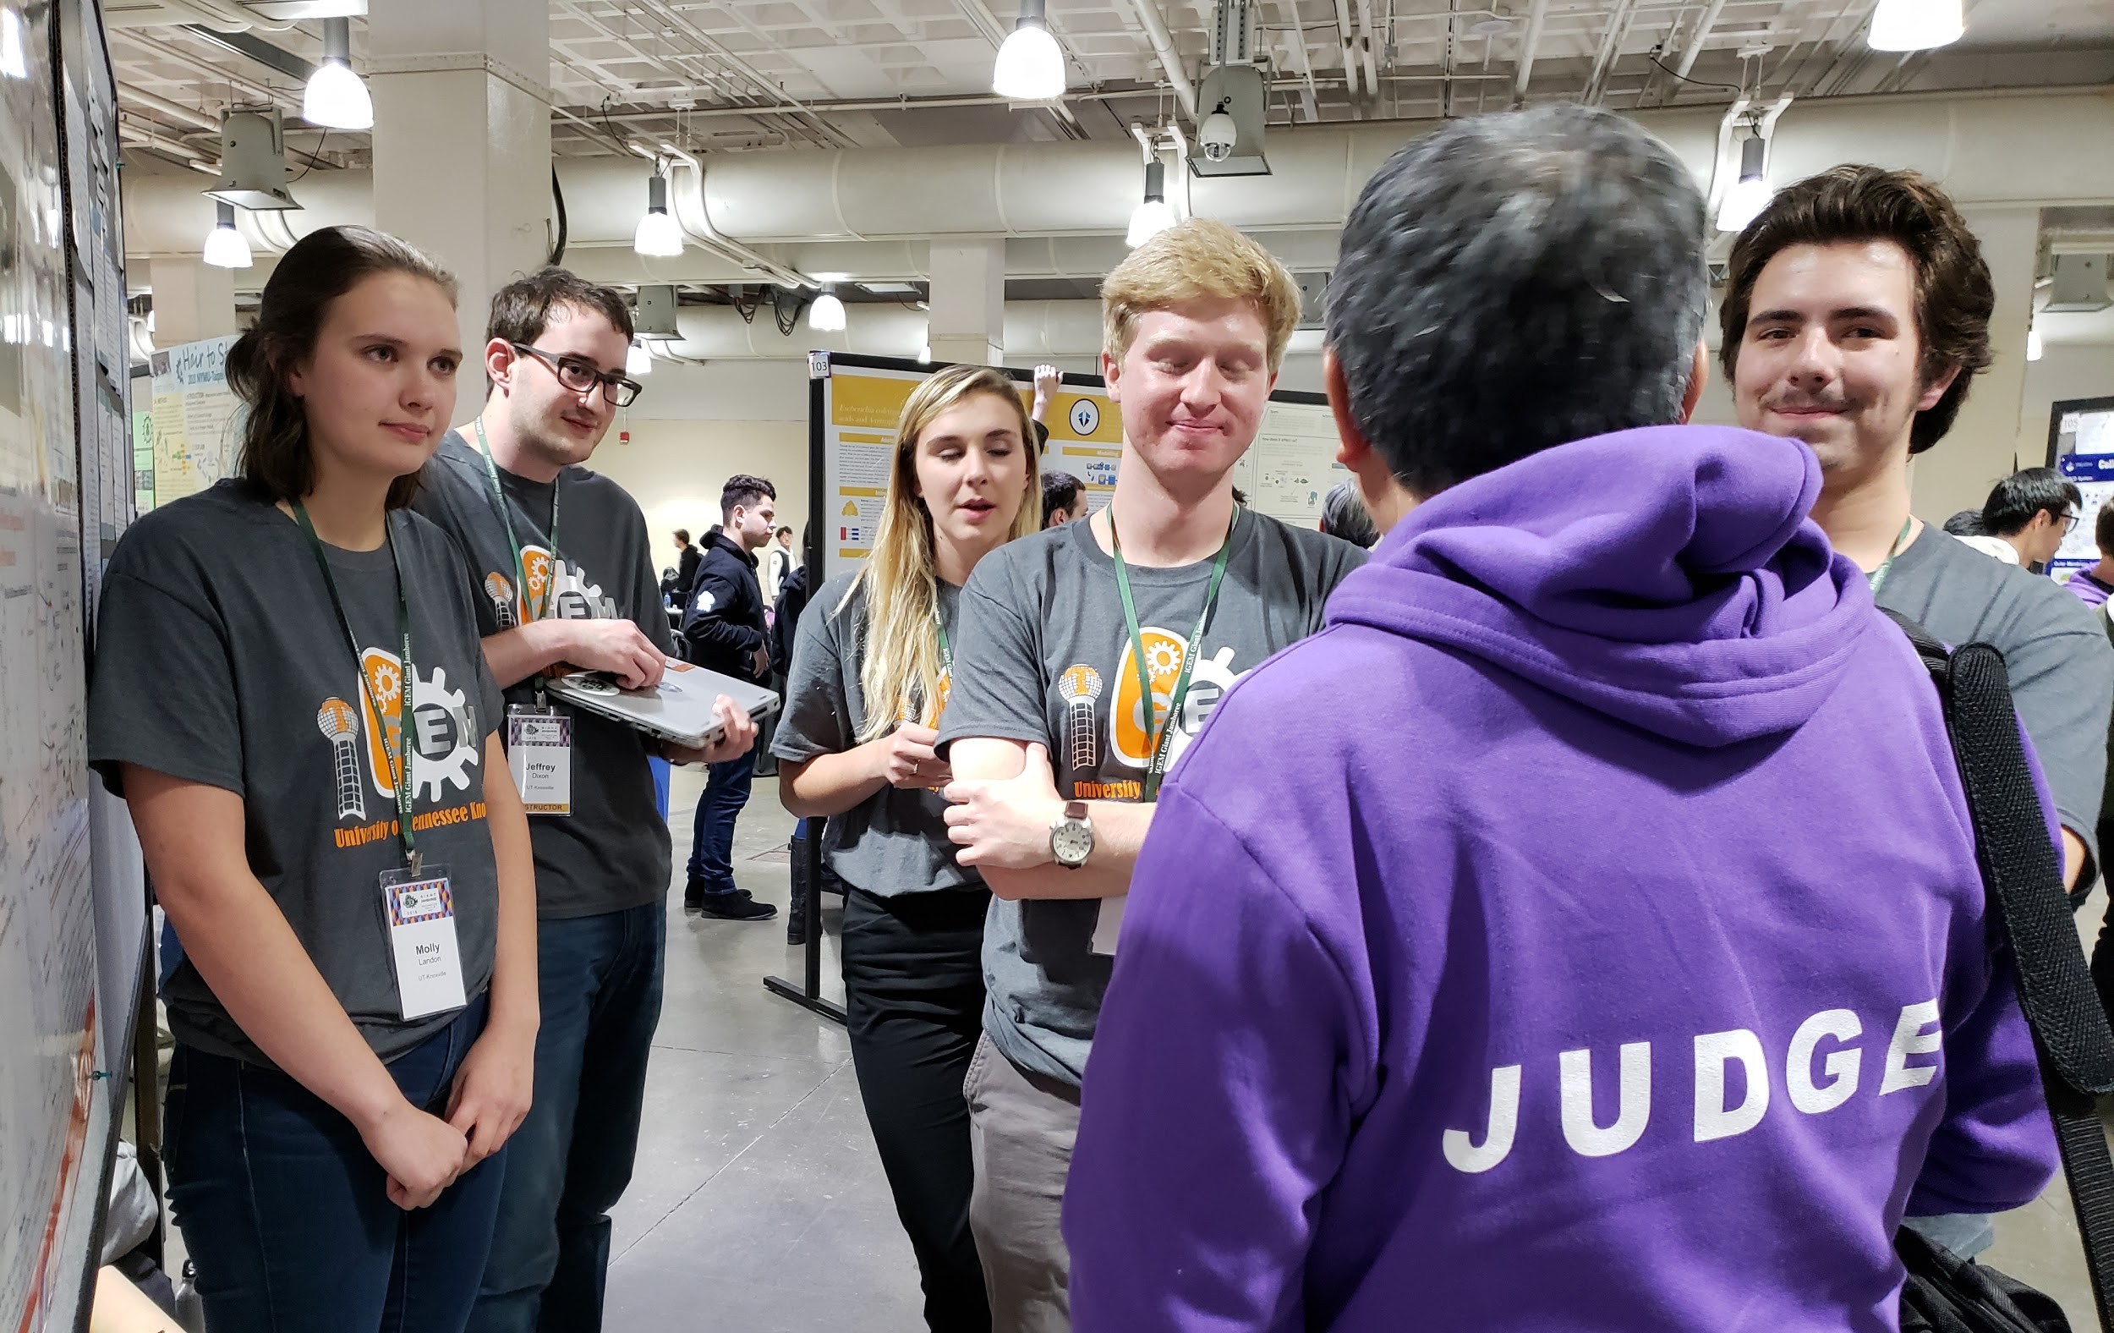
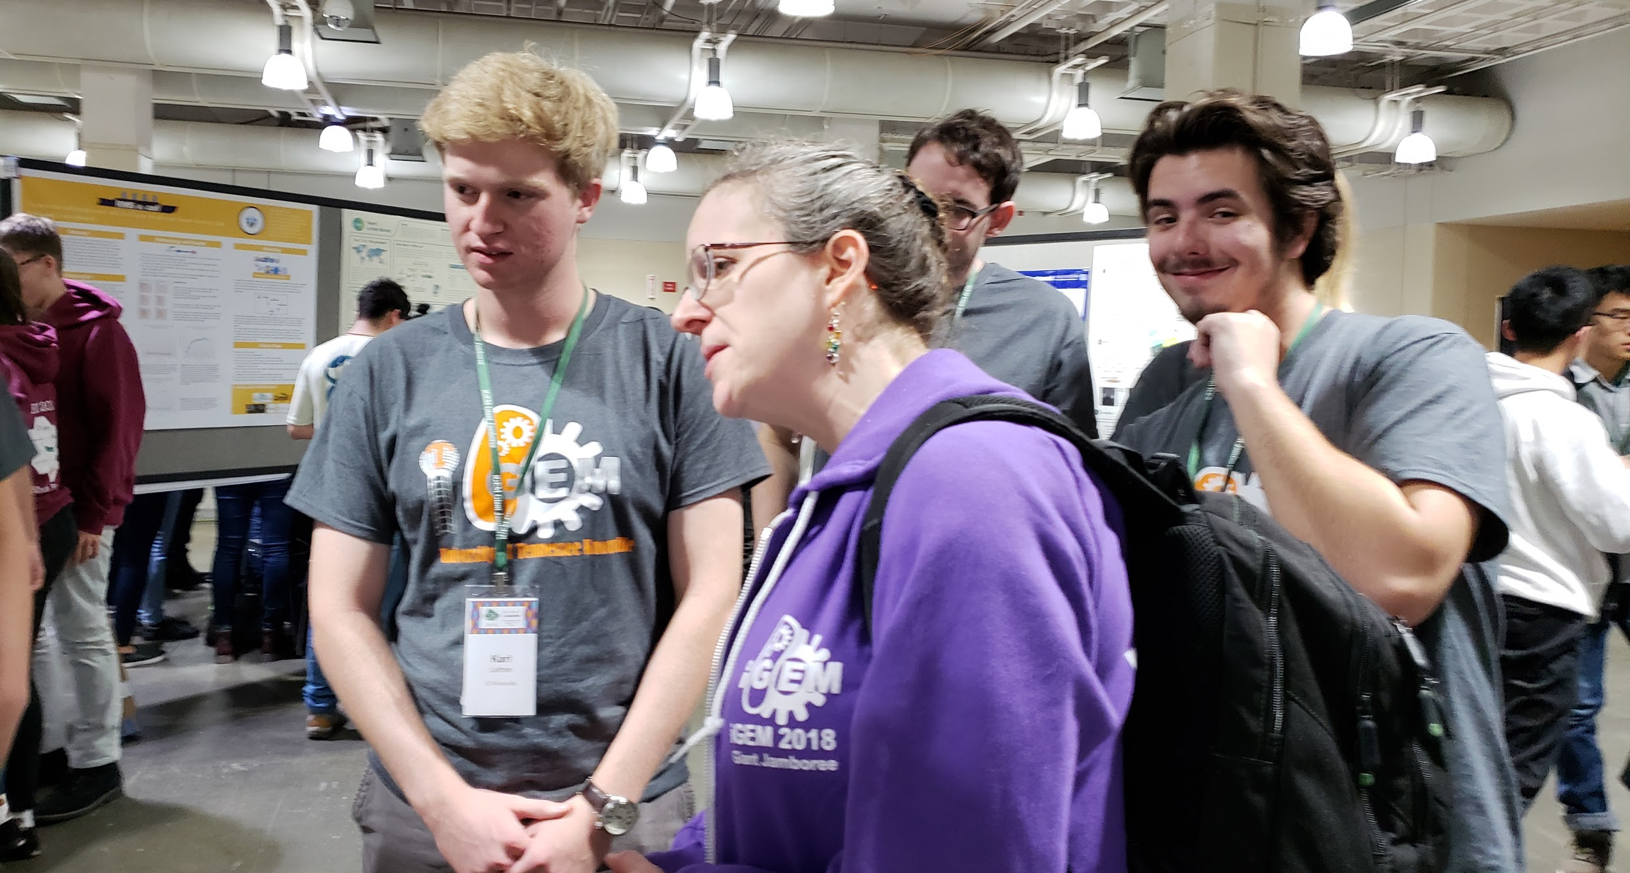
Arrival of the Judges
The group fields questions from the judges during the poster session

Slide 10
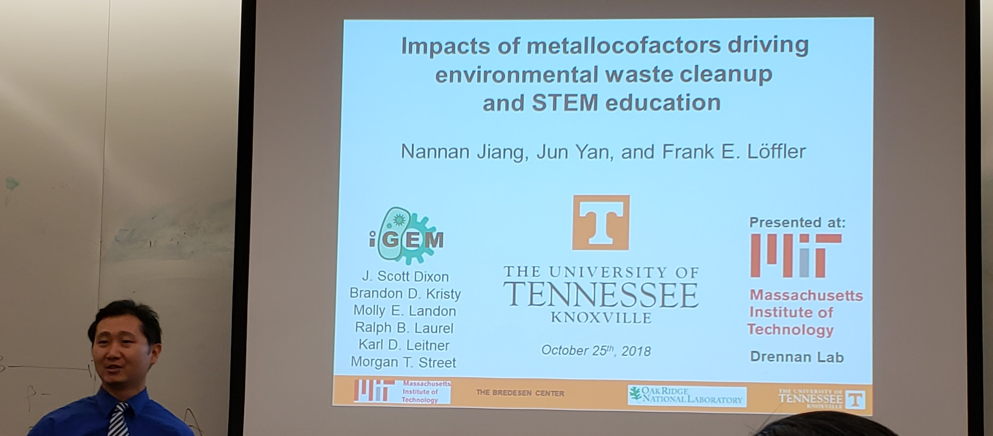
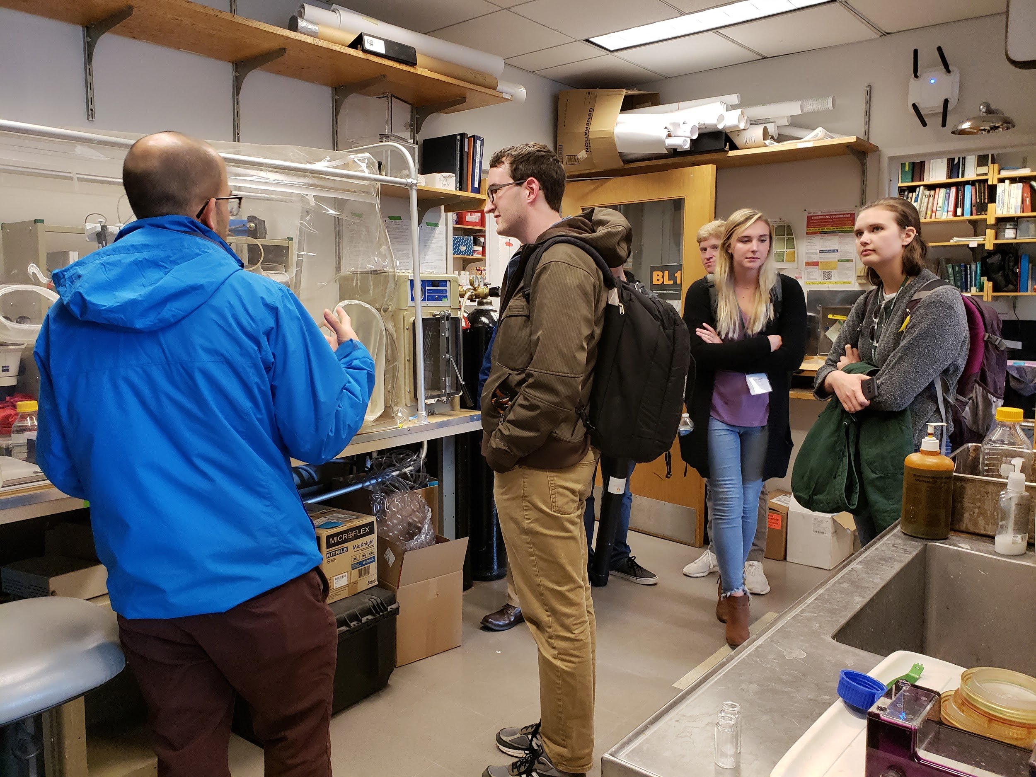
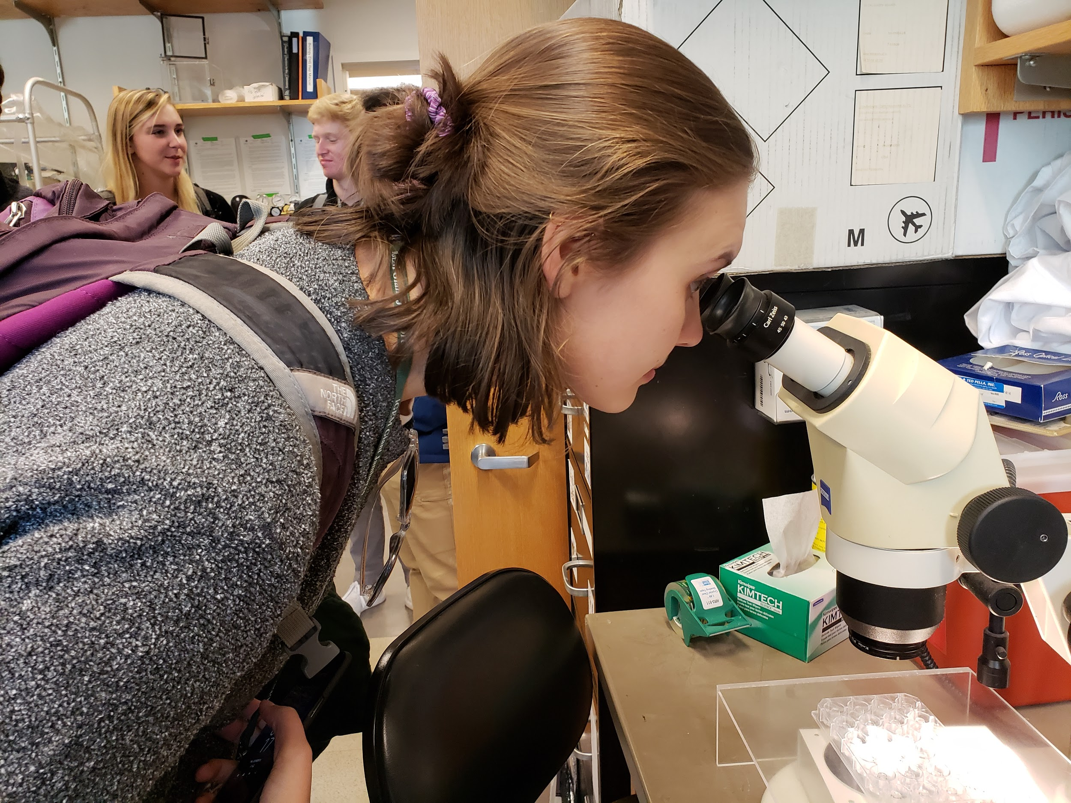
MIT Lab Tour (Drennan Lab)
The group is invited to attend a lab meeting and tours the Catherine Drennan lab at MIT

Slide 11
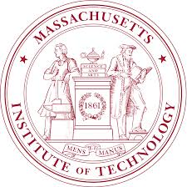
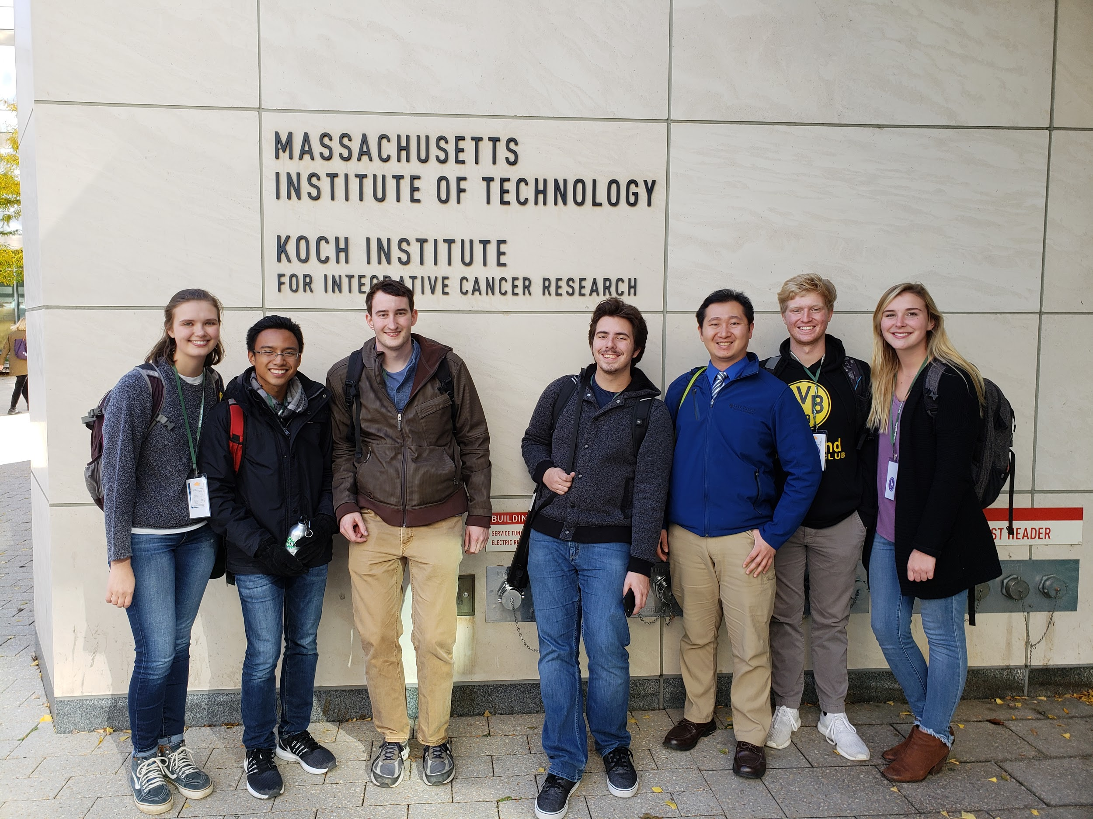
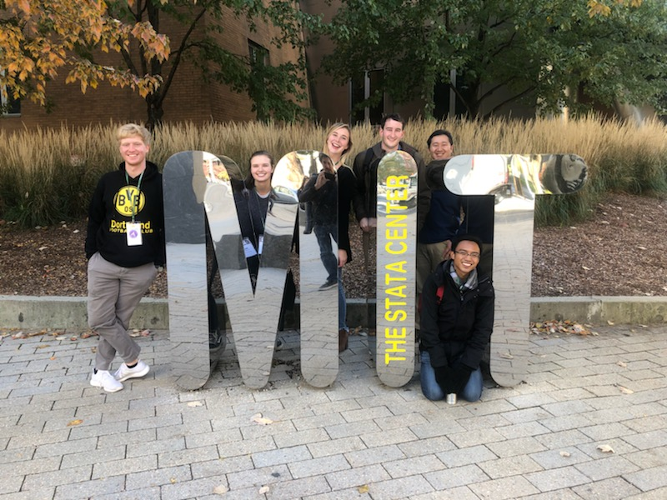
Exploring MIT

Slide 12
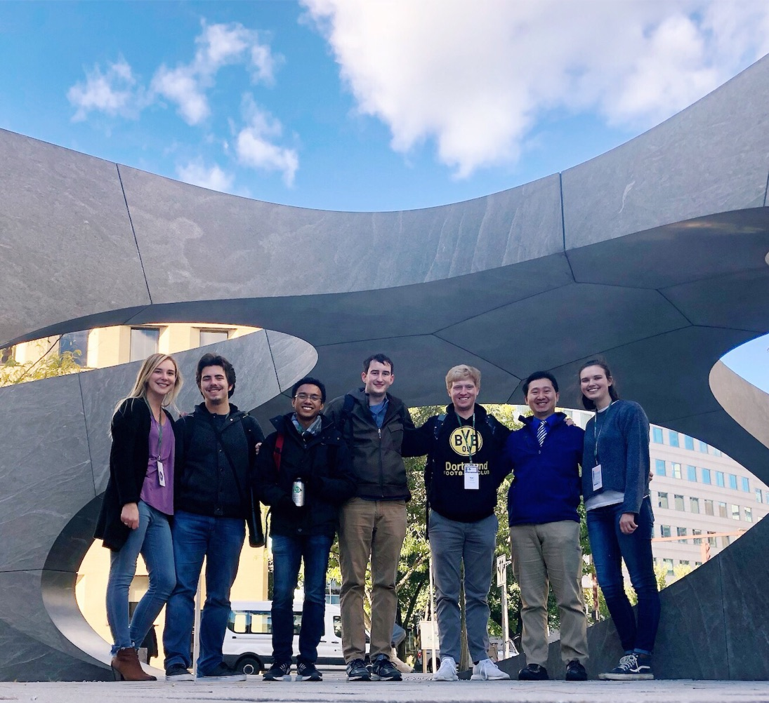

Slide 13
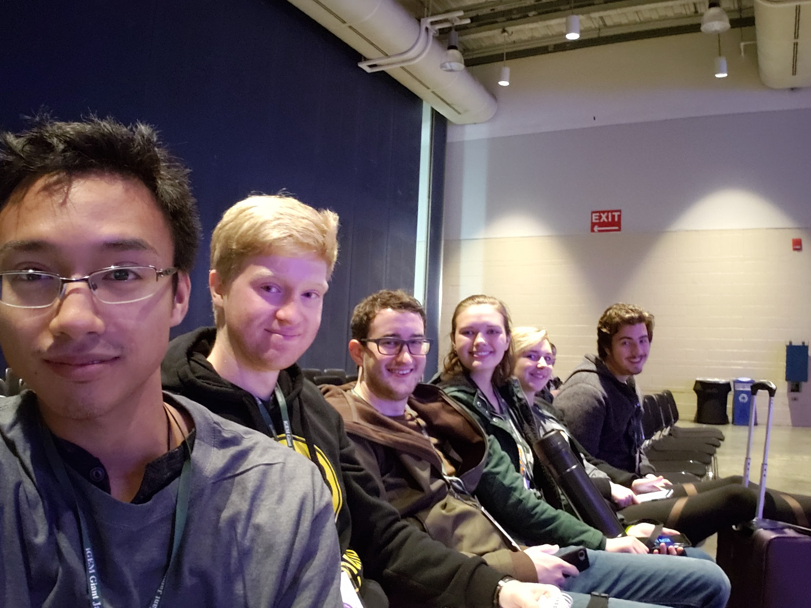
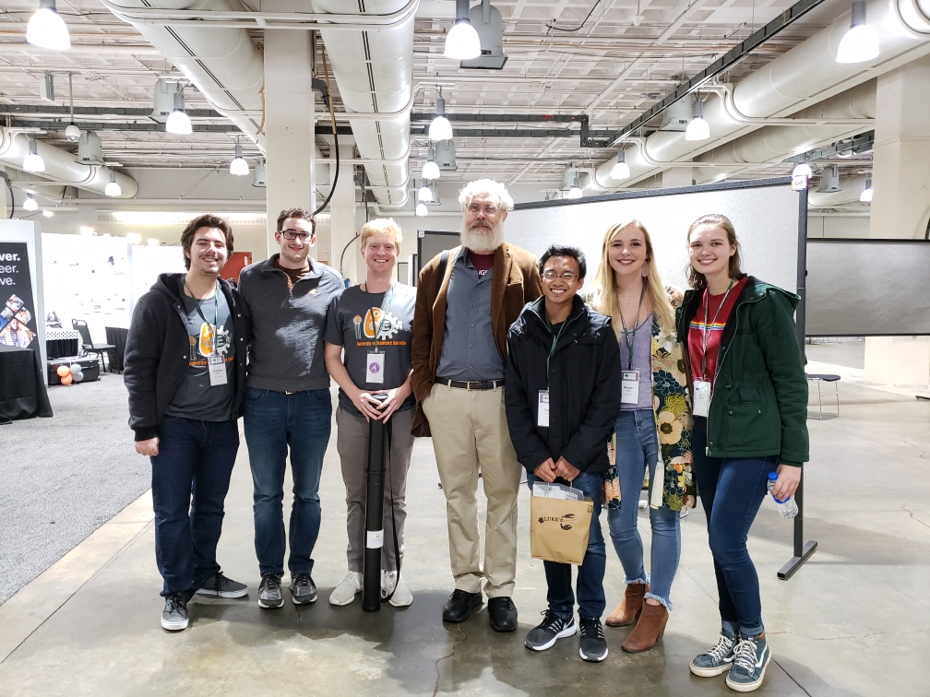
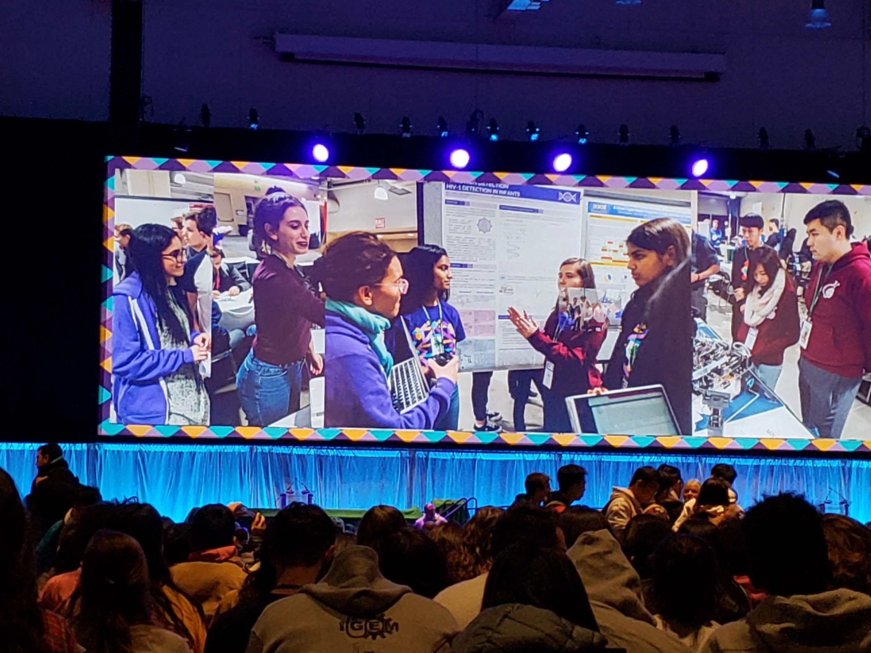
Final Day of Conference
Above: The group snags a picture with renowned American geneticist George Church before the closing ceremony

Slide 14
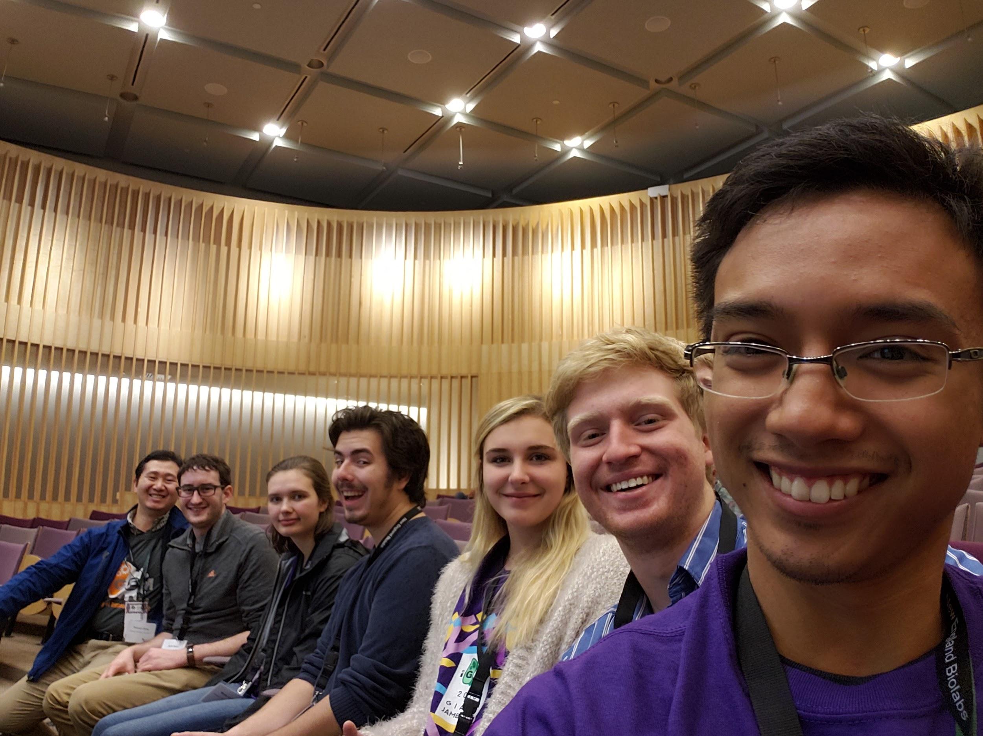
Tour of New England Biolabs
Our team was one of the five iGEM teams chosen to tour the NEB facility in Ipswich, MA

Slide 15
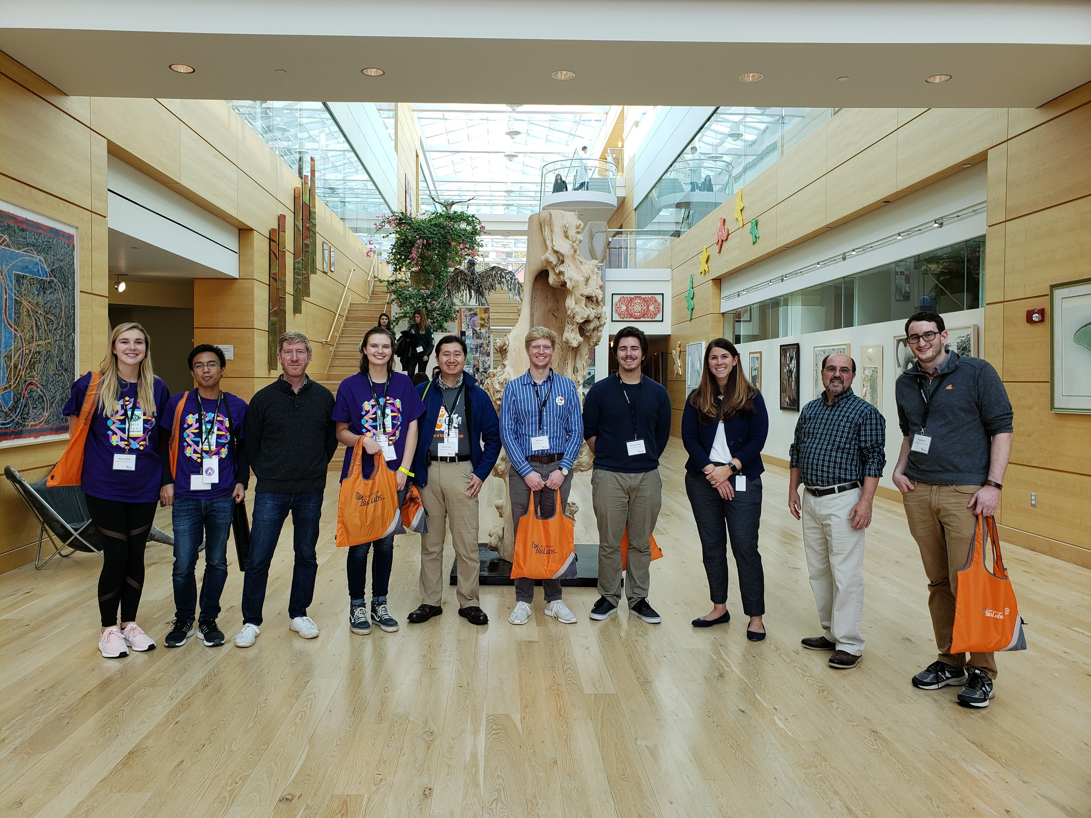
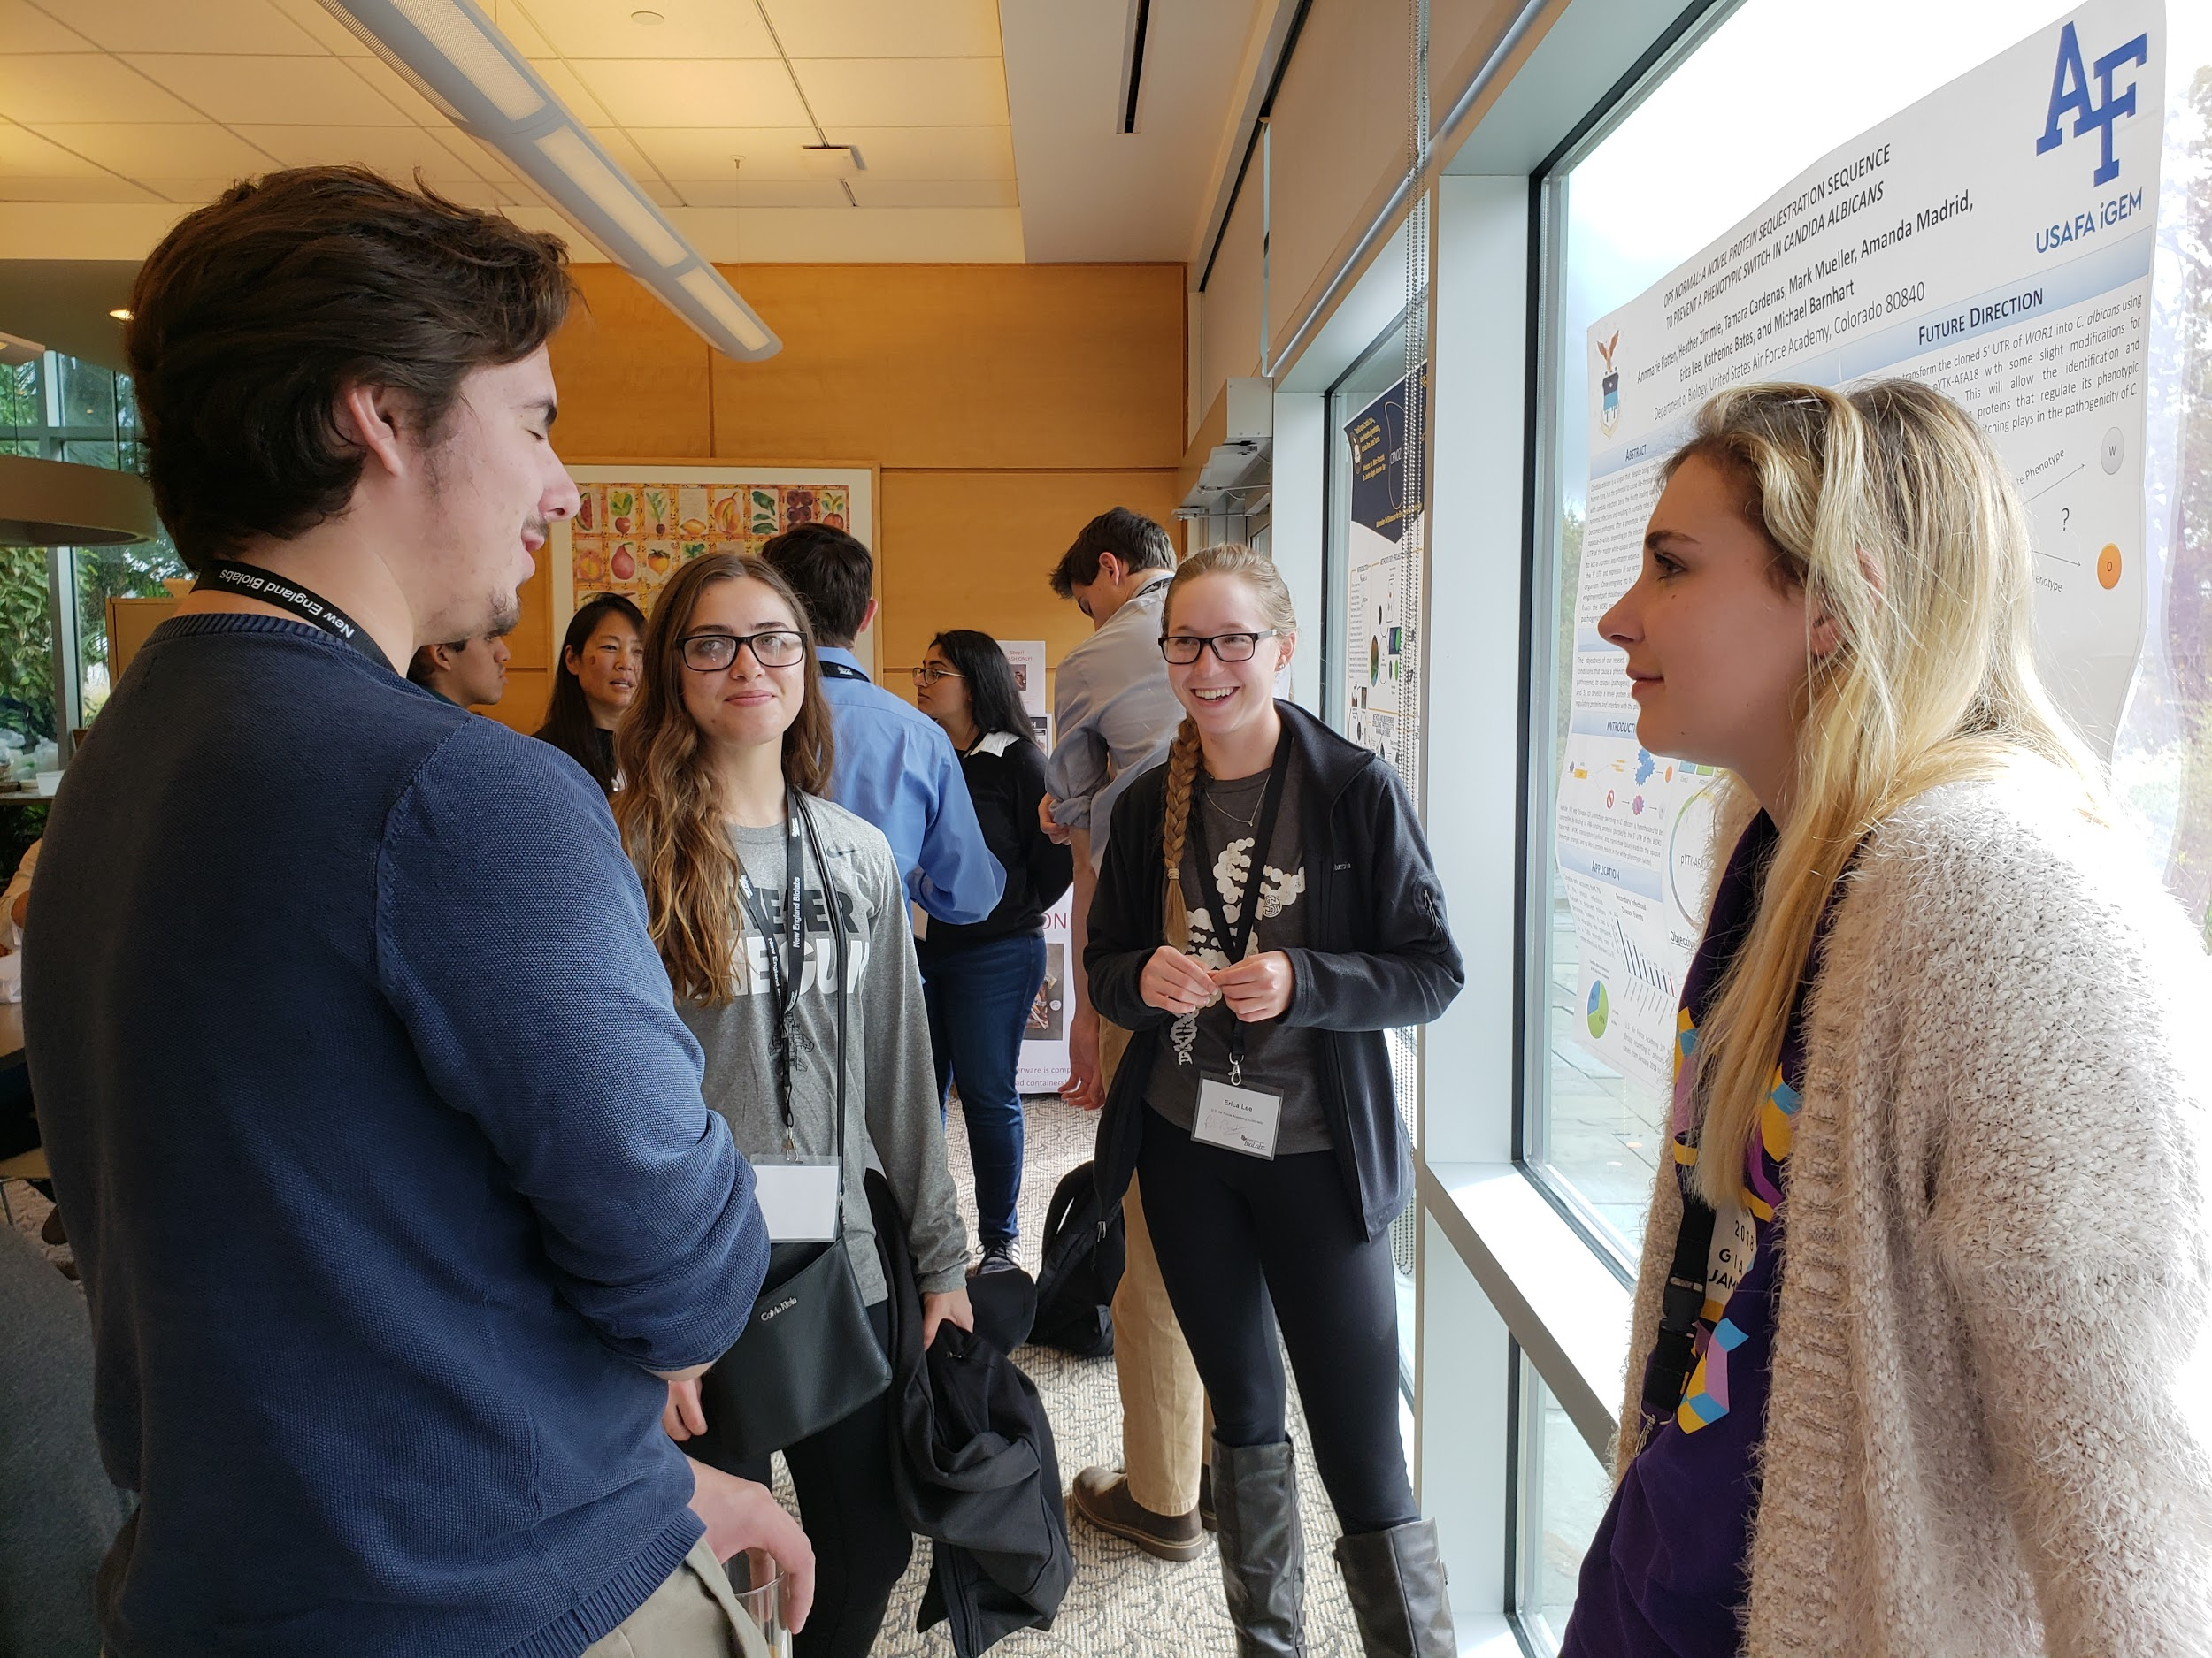
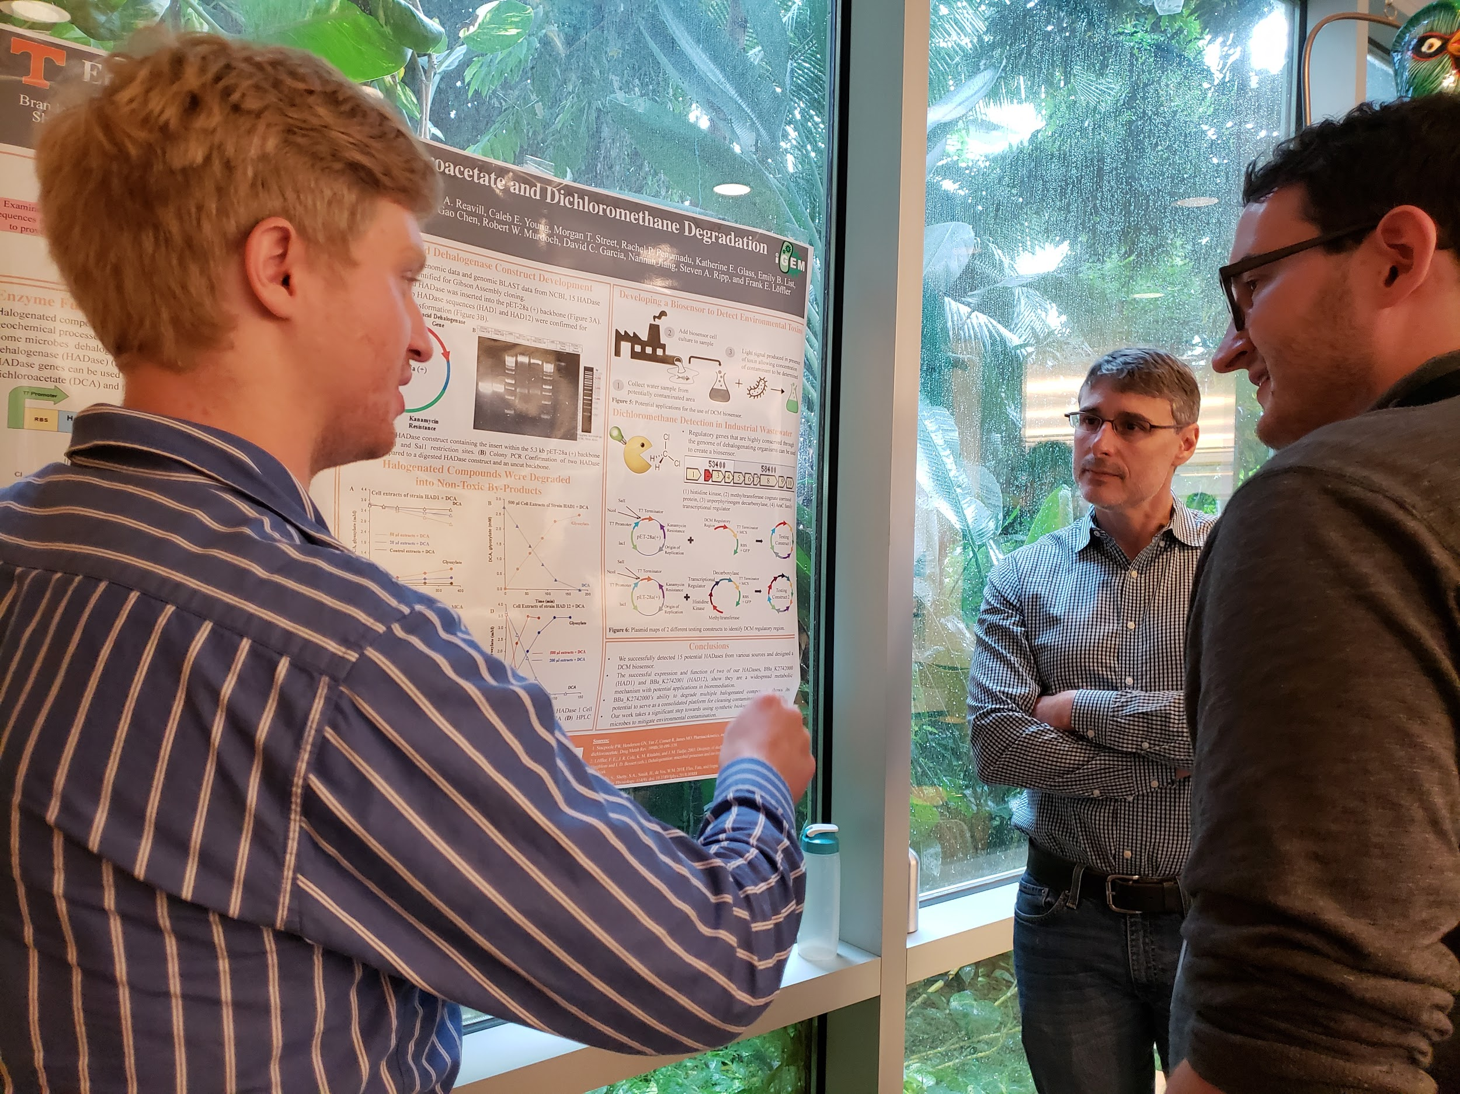
Below: Poster presentation at NEB
Above: Group photo with NEB employees Breton Hornblower and Kari Goodwin

Slide 16
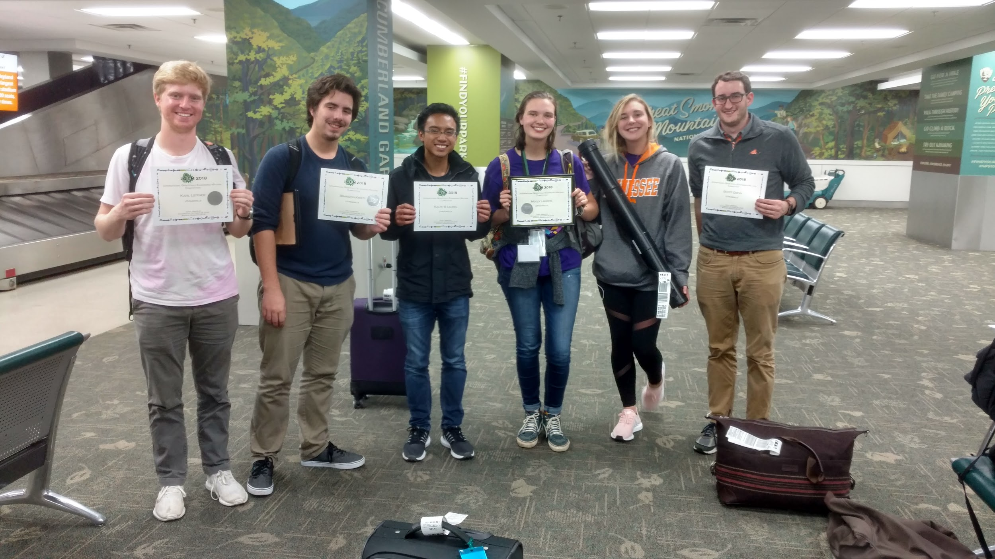
The group arrives in Knoxville, TN on Tuesday morning with their silver medal certificates
Coming Home

Slide 17
Acknowledgements
Chemical and Biomolecular Engineering
Tickle College of Engineering
Office of Undergraduate Research
The Microbiology Department
Biochemistry and Molecular Biology
Regenesis
Experiment
Biobasic, Inc
Chemours
Frank Loeffler
Steve Ripp
Nannan Jiang and David Garcia
The CBE office girls, from left to right:
Lindsi Whitaker, Amy Brewer, Ralph Laurel, Sarah Humphries, Amber Tipton (not pictured: Kerri Cline, Rita Gray)

Slide 18
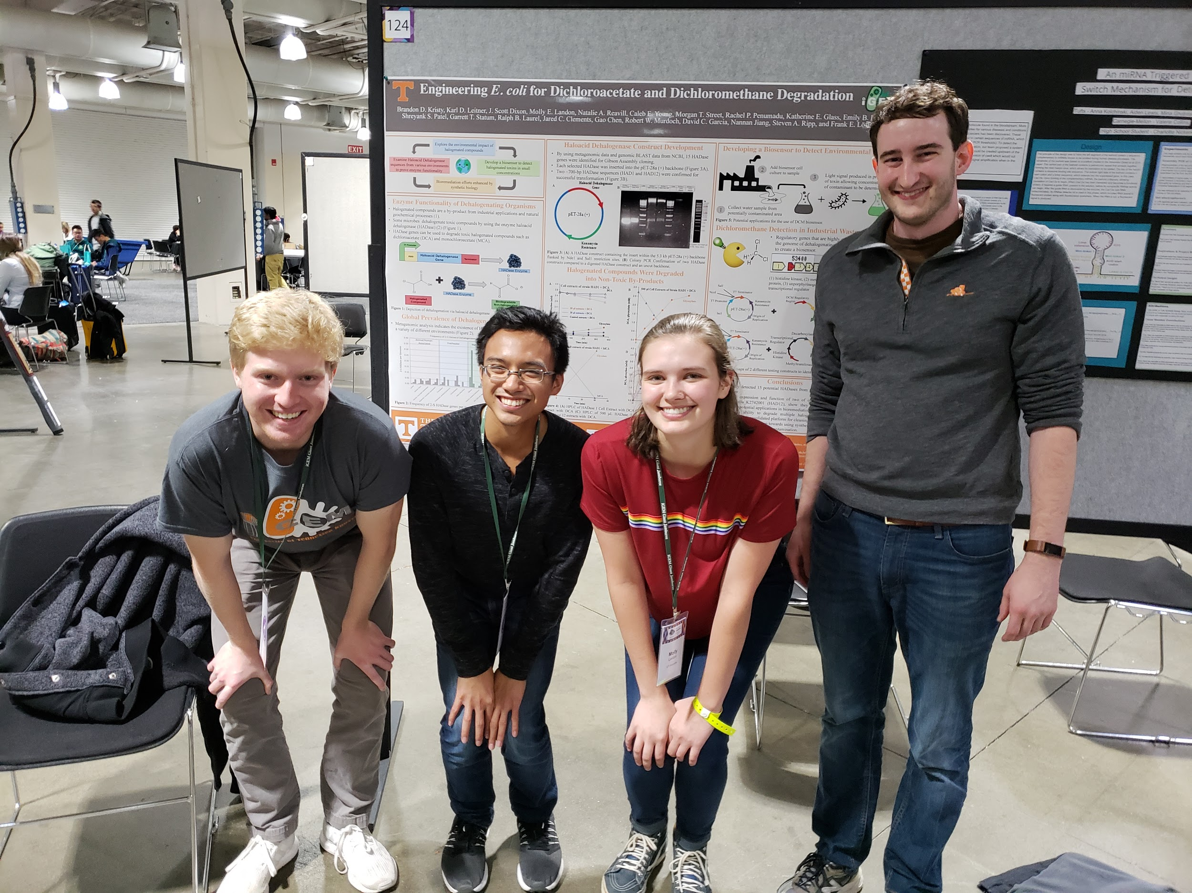
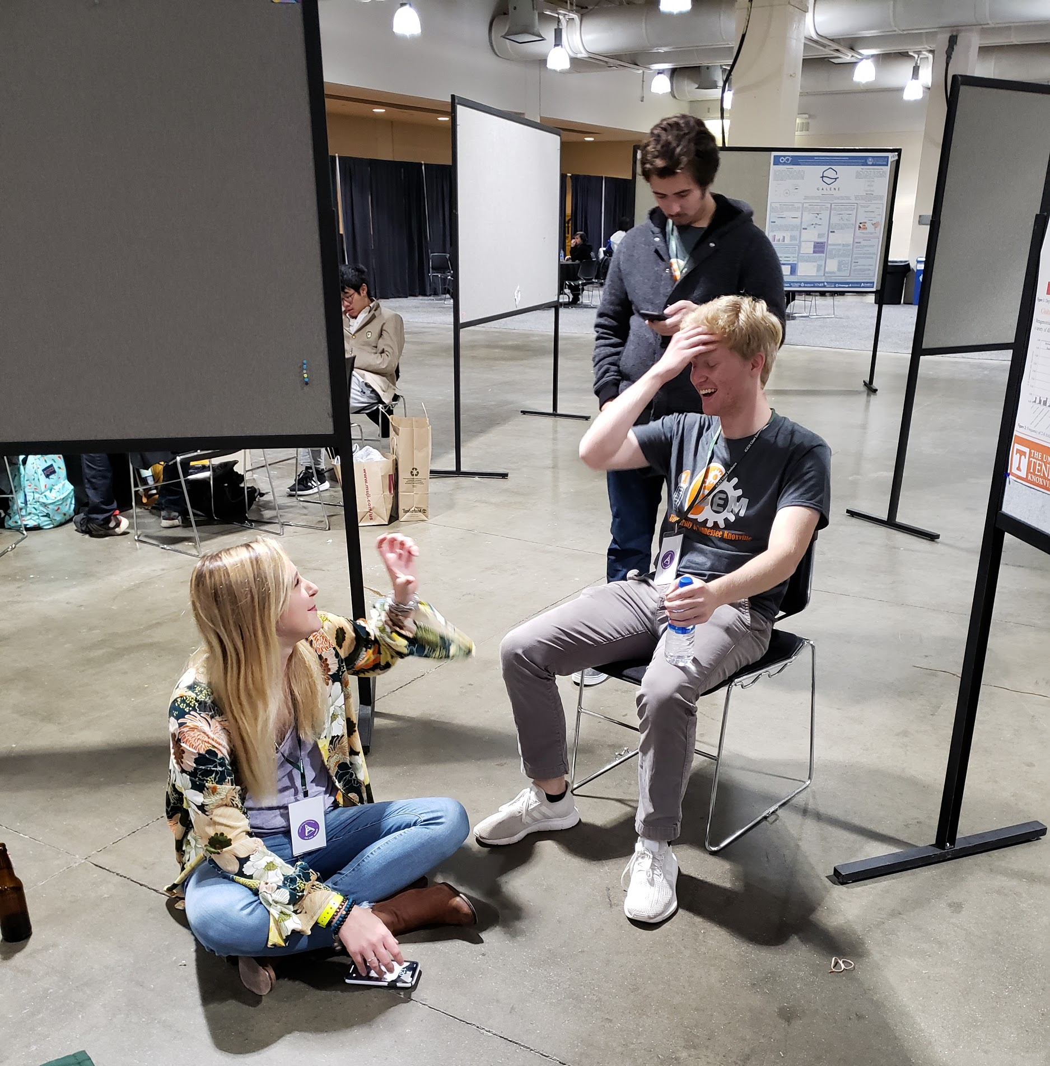
Silly Pictures
Senior squad poses sorority style (except Scott)

Slide 19
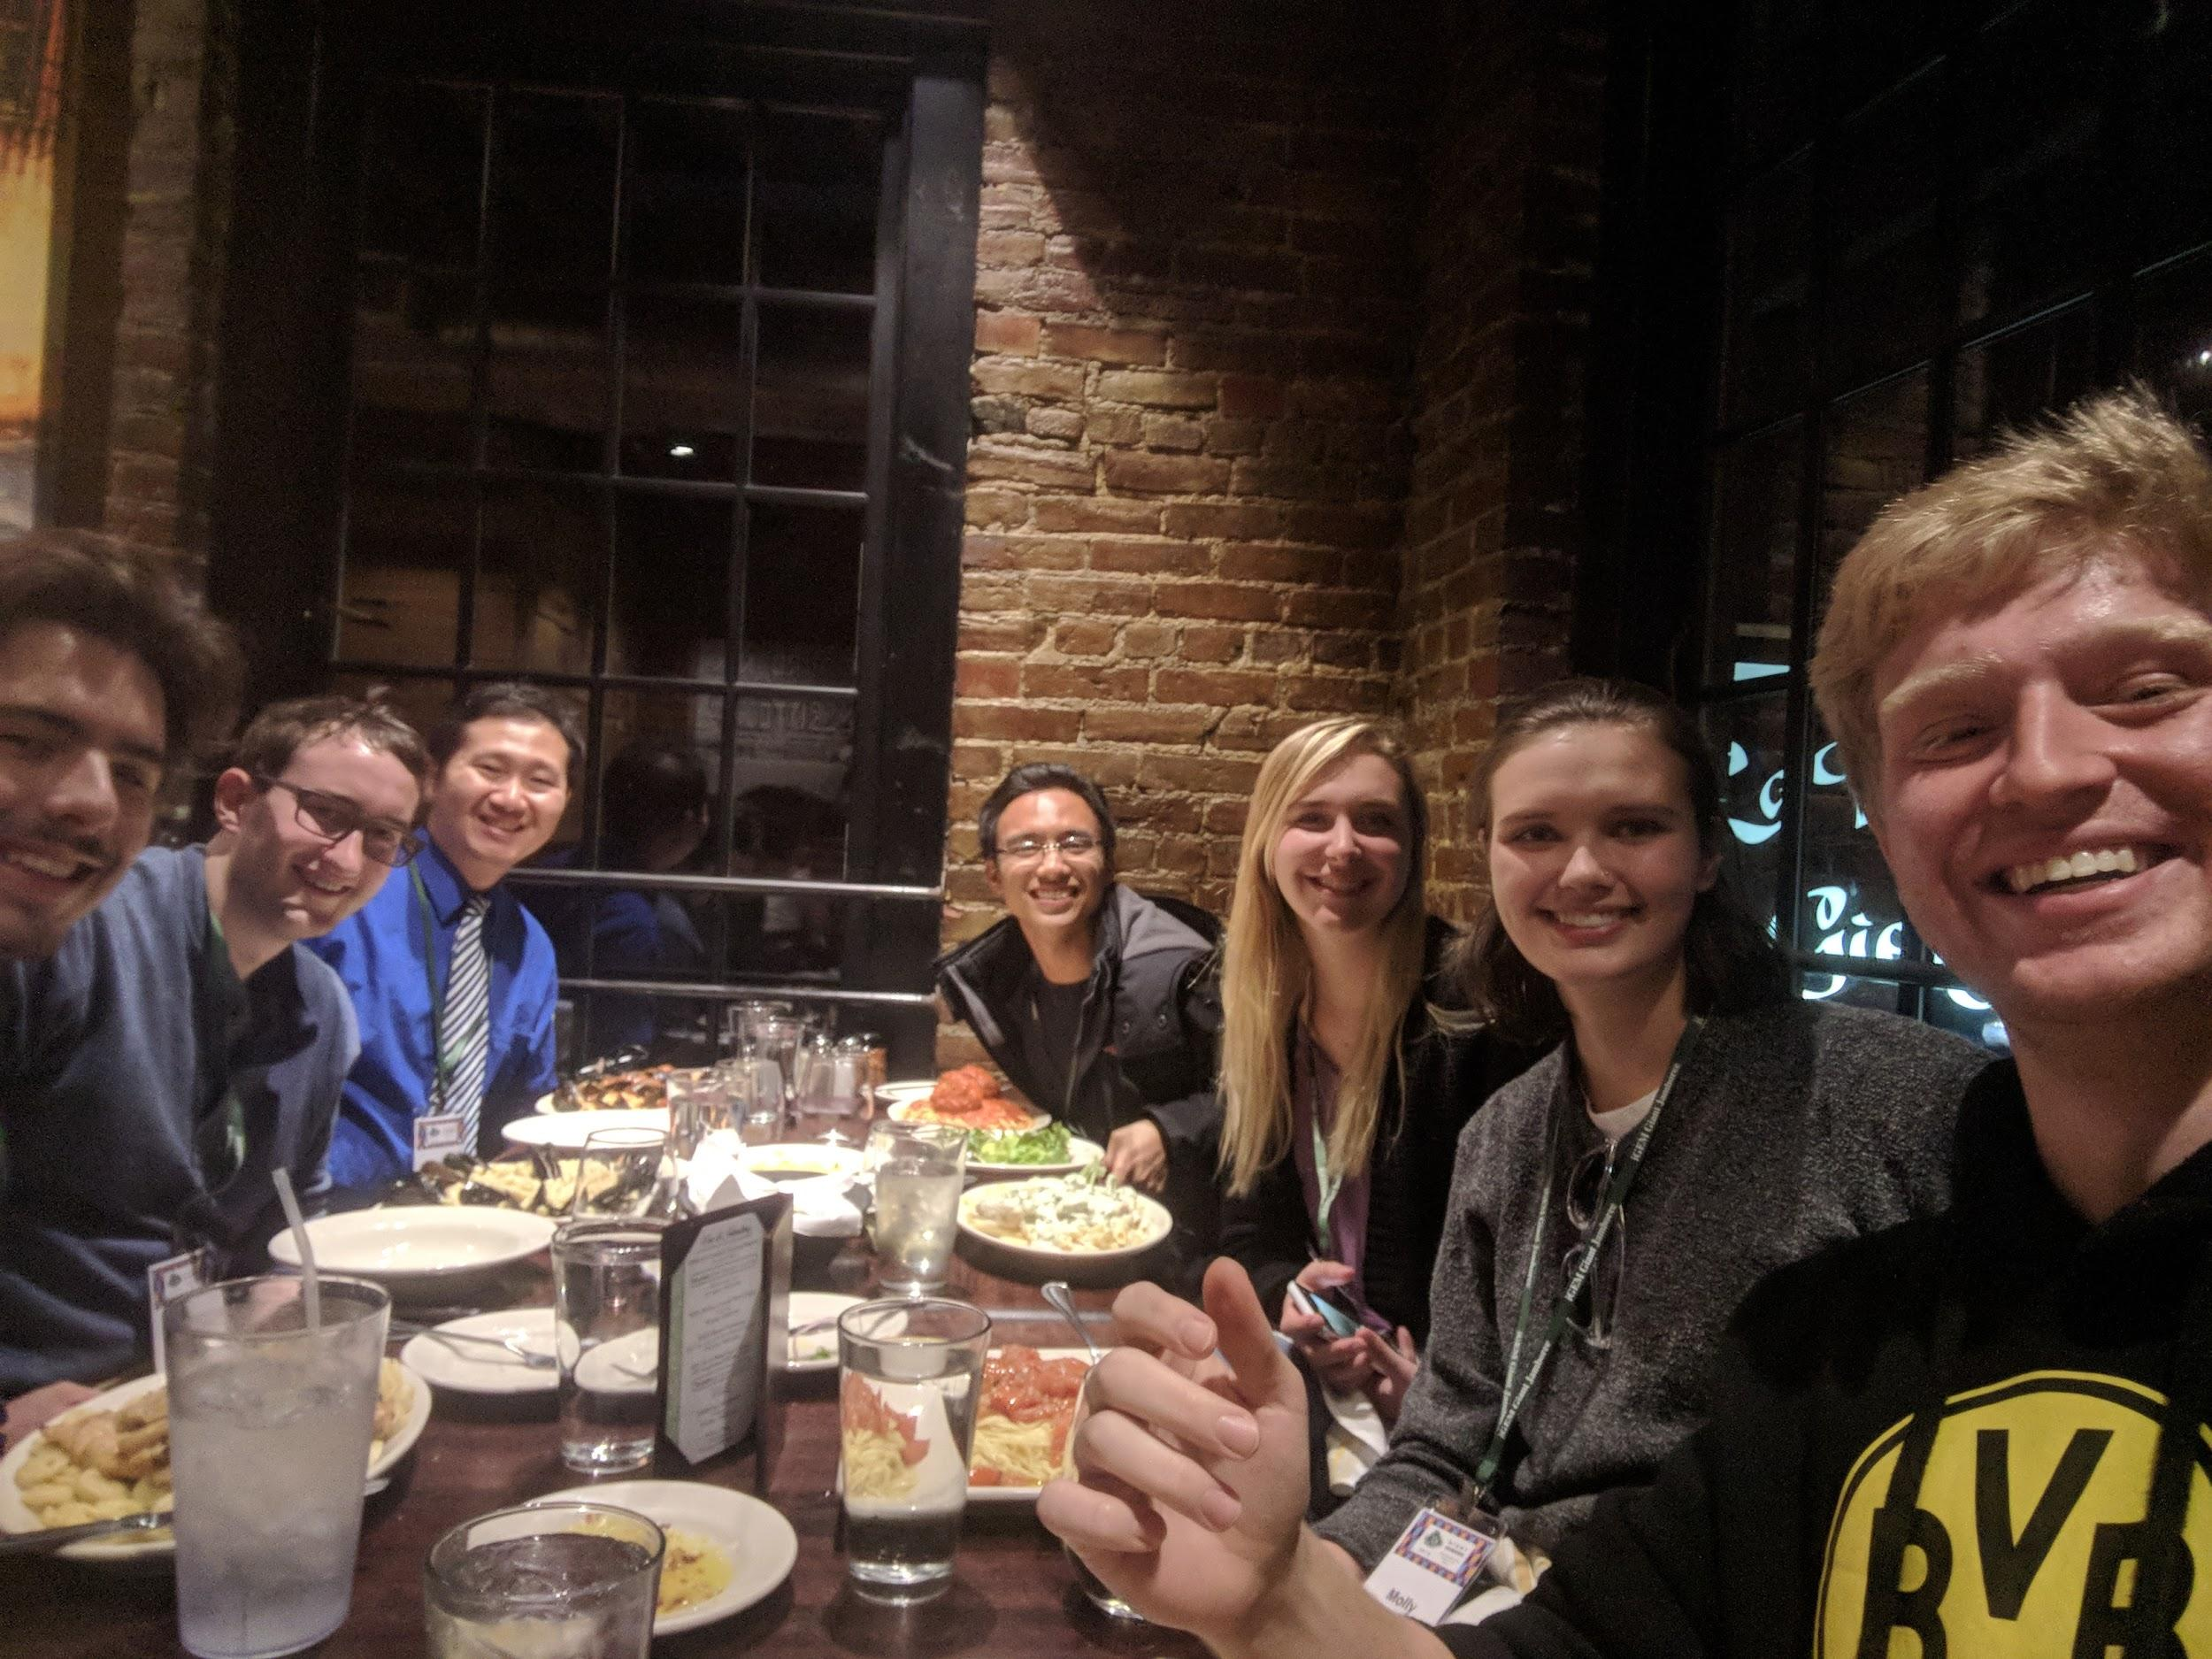
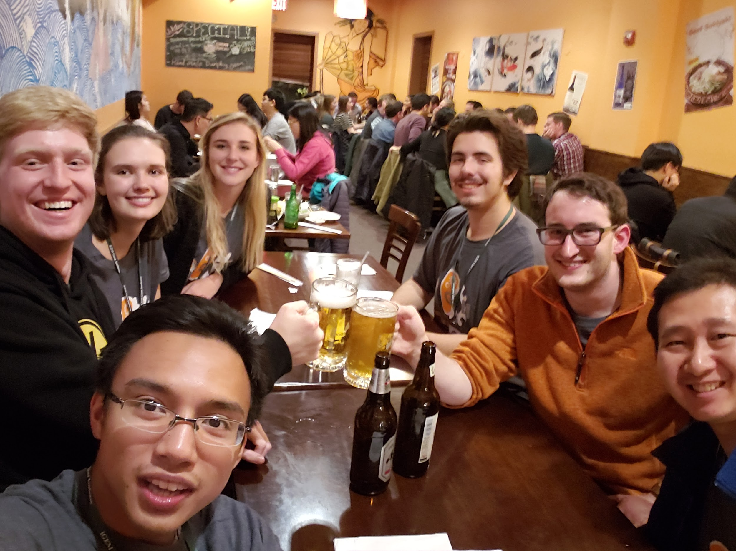
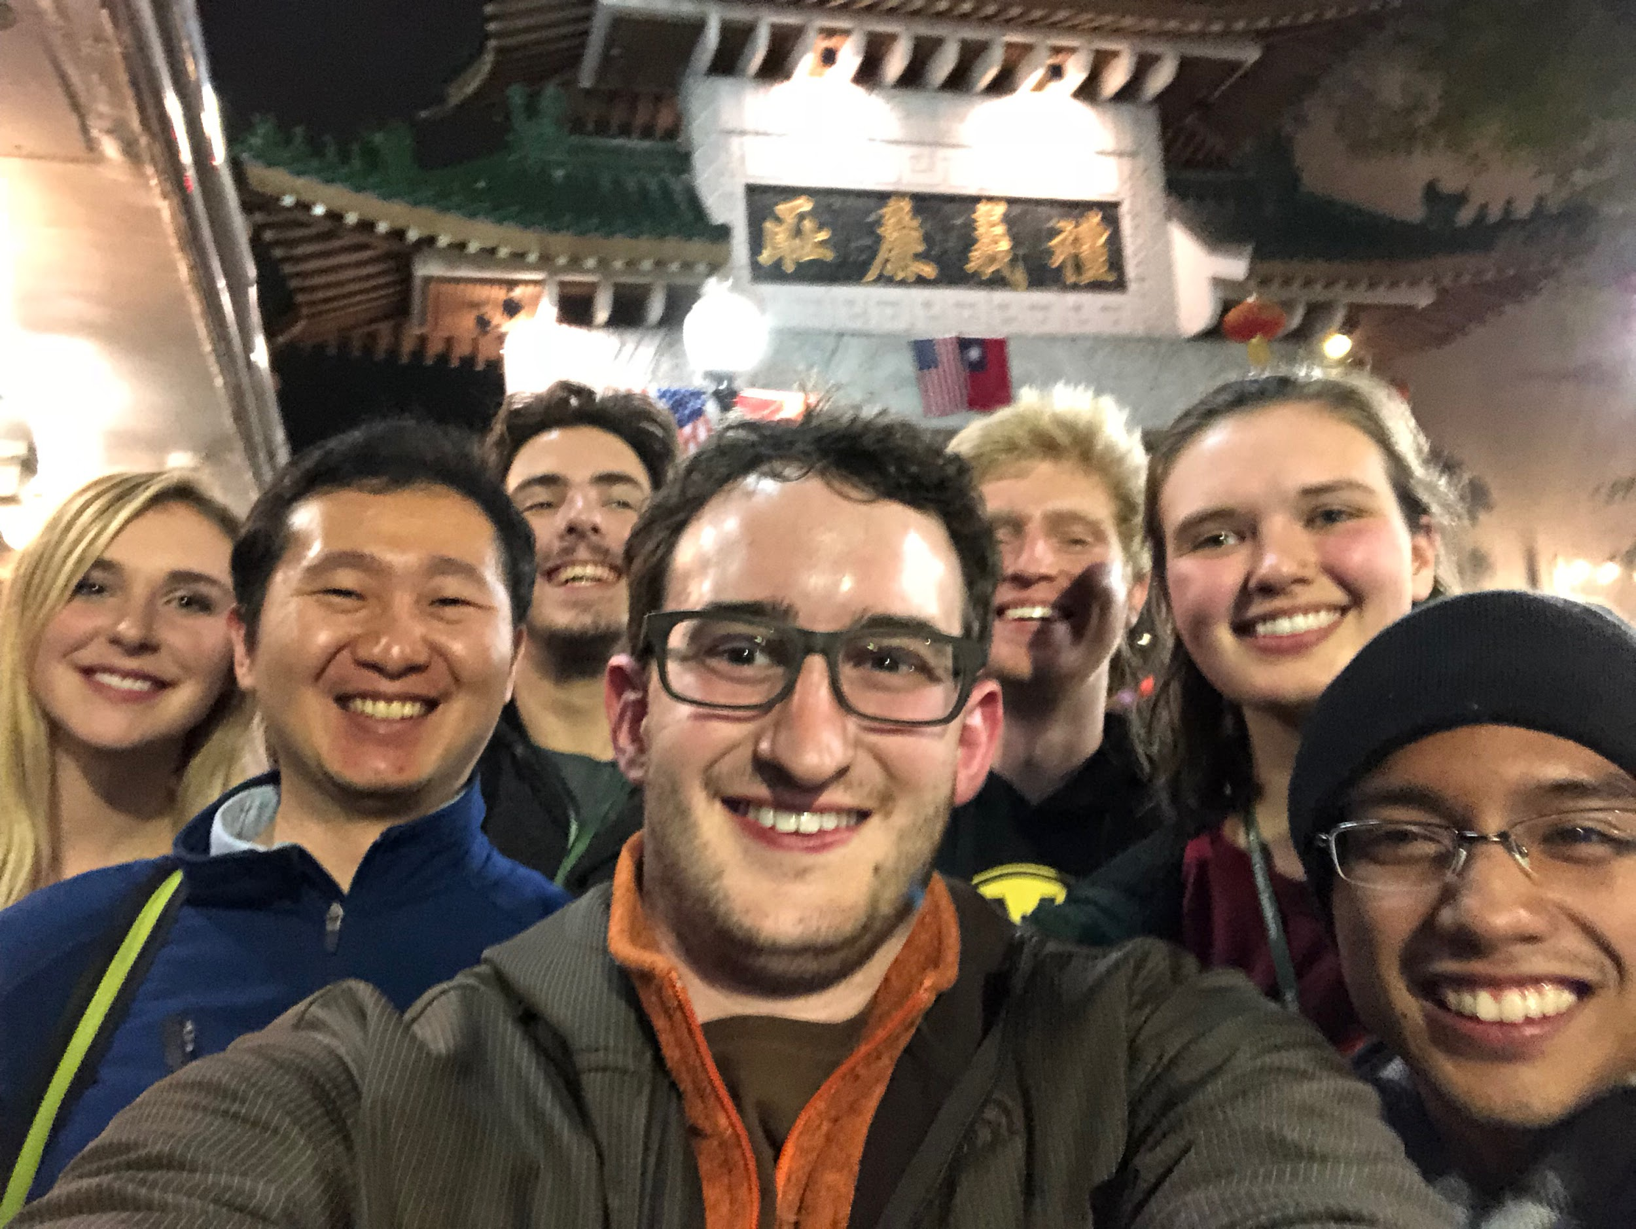
Cheers!

